Slide 1

Bevis ved induktion
Vi ønsker at bevise en uendelig række udsagn
U₁, U₂, U₃, U₄, U₅, ..., U_{n}, U_{n+1}, ....
F.eks. kan U_{n} være udsagnet: $\sum_{i=1}^{n}{i^{2}=\frac{n\left(n+1\right)(2n+1)}{6}}$
Udsagnene kan bevises v.h.a. induktionsprincipet, ved at bevise følgende to udsagn:
Basis:
Vis at U₁ gælder
Induktionsskridt:
Antag for et n ≥ 1 at U_{n} gælder (induktionshypotese)
og vis så at U_{n+1} gælder, dvs. vis at U_{n} U_{n+1}

Slide 2
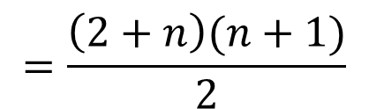
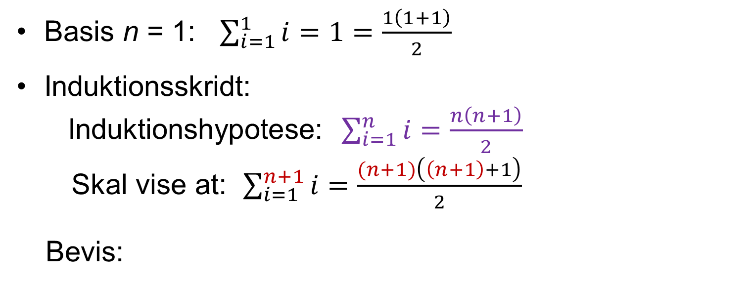
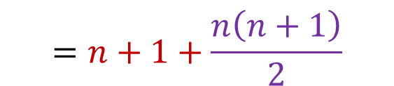
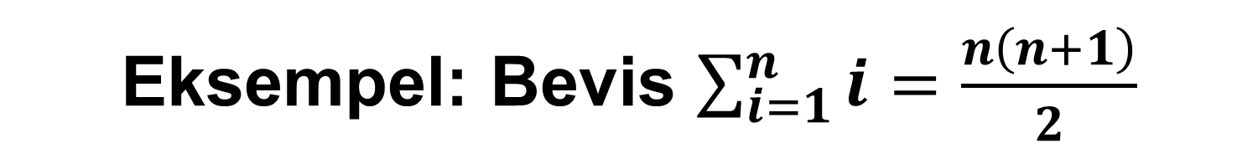
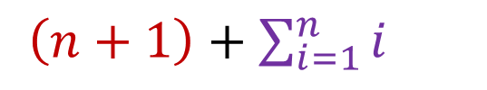

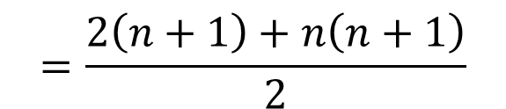
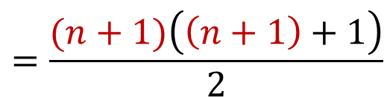
Eksempel: Bevis $\sum_{i=1}^{n}{i=\frac{n\left(n+1\right)}{2}}$
[CLRS A.1] (A.1)
Basis n = 1: $\sum_{i=1}^{1}{i=1=\frac{1\left(1+1\right)}{2}}$
Induktionsskridt:
Induktionshypotese: $\sum_{i=1}^{n}{i=\frac{n\left(n+1\right)}{2}}$
Skal vise at: $\sum_{i=1}^{n+1}{i=\frac{(n+1)\left(\left(n+1\right)+1\right)}{2}}$
Bevis:
$$=n+1+\frac{n\left(n+1\right)}{2}$$
$\sum_{i=1}^{n+1}{i}=$
$\left(n+1\right)+\sum_{i=1}^{n}{i}$
$$=\frac{2\left(n+1\right)+n\left(n+1\right)}{2}$$
$$=\frac{\left(2+n\right)(n+1)}{2}$$
$$=\frac{(n+1)\left(\left(n+1\right)+1\right)}{2}$$

Slide 3
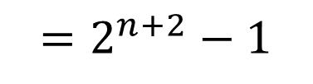
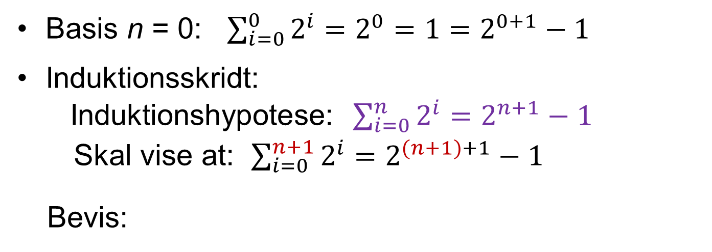
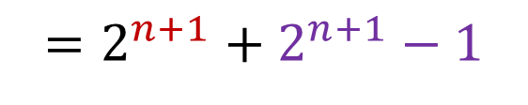

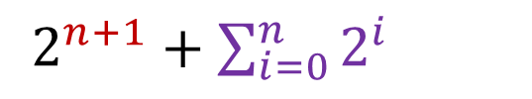
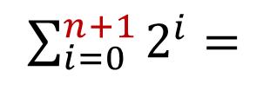

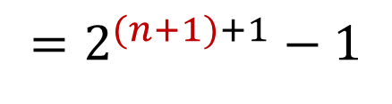
Eksempel: Bevis $\sum_{i=0}^{n}{2^{i}=2^{n+1}−1}$
[CLRS A.1] (A.5)
Basis n = 0: $\sum_{i=0}^{0}{2^{i}=2^{0}=1=2^{0+1}−1}$
Induktionsskridt:
Induktionshypotese: $\sum_{i=0}^{n}{2^{i}=2^{n+1}−1}$
Skal vise at: $\sum_{i=0}^{n+1}{2^{i}=2^{(n+1)+1}−1}$
Bevis:
$\sum_{i=0}^{n+1}{2^{i}}=$
$2^{n+1}+\sum_{i=0}^{n}{2^{i}}$
$$=2^{n+1}+2^{n+1}−1$$
$$=2∙2^{n+1}−1$$
$$=2^{n+2}−1$$
$$=2^{(n+1)+1}−1$$

Slide 4
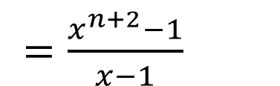
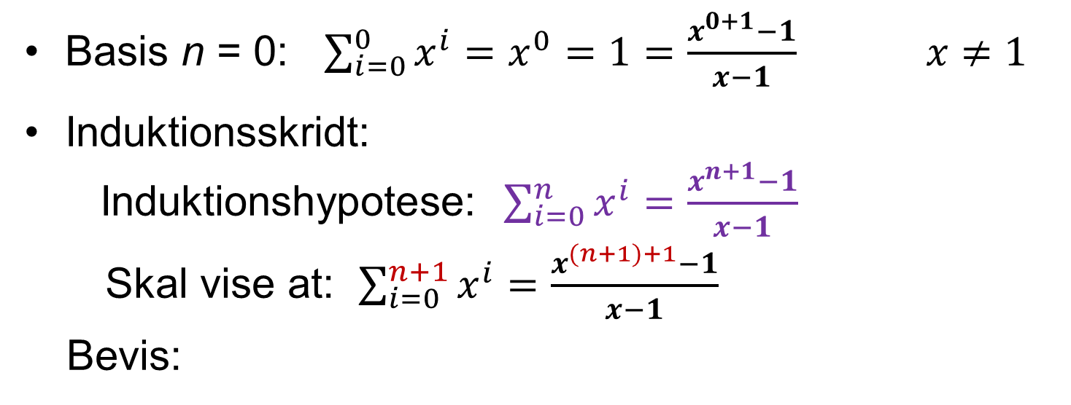
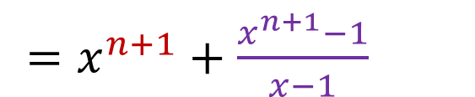
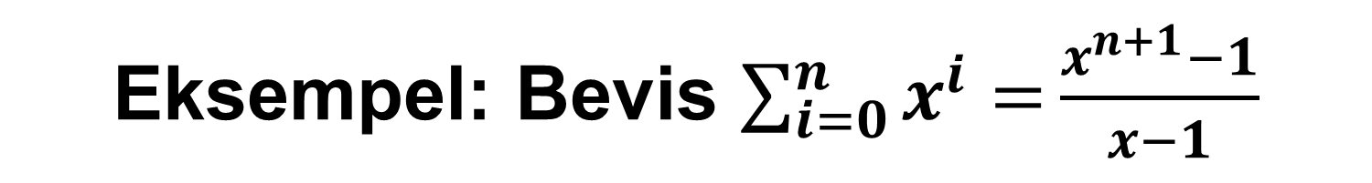
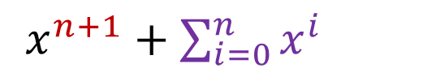
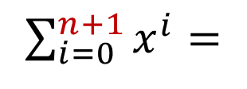
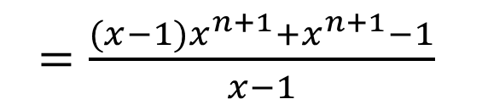
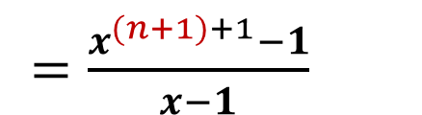
Eksempel: Bevis $\sum_{i=0}^{n}{x^{i}=}\frac{x^{n+1}−1}{x−1}$
[CLRS A.1] (A.5)
Basis n = 0: $\sum_{i=0}^{0}{x^{i}=x^{0}=1=\frac{x^{0+1}−1}{x−1} x≠1}$
Induktionsskridt:
Induktionshypotese: $\sum_{i=0}^{n}{x^{i}=\frac{x^{n+1}−1}{x−1}}$
Skal vise at: $\sum_{i=0}^{n+1}{x^{i}=\frac{x^{(n+1)+1}−1}{x−1}}$
Bevis:
$=x^{n+1}+\frac{x^{n+1}−1}{x−1}$
$\sum_{i=0}^{n+1}{x^{i}}=$
$x^{n+1}+\sum_{i=0}^{n}{x^{i}}$
$=\frac{(x−1)x^{n+1}+x^{n+1}−1}{x−1}$
$=\frac{x^{n+2}−1}{x−1}$
$=\frac{x^{(n+1)+1}−1}{x−1}$

Slide 5
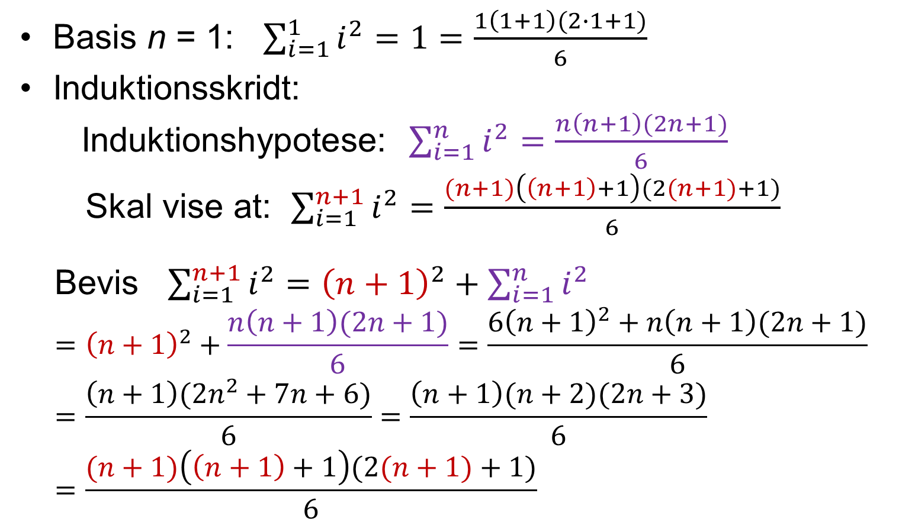

Eksempel: Bevis $\sum_{i=1}^{n}{i^{2}=\frac{n\left(n+1\right)(2n+1)}{6}}$
[CLRS A.1] (A.3)
Basis n = 1: $\sum_{i=1}^{1}{i^{2}=1=\frac{1\left(1+1\right)(2∙1+1)}{6}}$
Induktionsskridt:
Induktionshypotese: $\sum_{i=1}^{n}{i^{2}=\frac{n\left(n+1\right)(2n+1)}{6}}$
Skal vise at: $\sum_{i=1}^{n+1}{i^{2}=\frac{(n+1)\left(\left(n+1\right)+1\right)(2(n+1)+1)}{6}}$
Bevis $\sum_{i=1}^{n+1}{i^{2}}={\left(n+1\right)}^{2}+\sum_{i=1}^{n}{i^{2}}$
$$={\left(n+1\right)}^{2}+\frac{n\left(n+1\right)(2n+1)}{6}=\frac{6{\left(n+1\right)}^{2}+n\left(n+1\right)(2n+1)}{6}=\frac{\left(n+1\right)({2n}^{2}+7n+6)}{6}=\frac{\left(n+1\right)(n+2)(2n+3)}{6}=\frac{(n+1)\left(\left(n+1\right)+1\right)(2(n+1)+1)}{6}$$

