Slide 1
lsb(x) = Least Significant Bit ?
 | w-1 |  |  |  |  |  |  |  |  |  | lsb i |  |  |  | 1 | 0
x | 0 | 0 | 1 | 0 | 1 | 0 | 1 | 1 | 0 | 0 | 1 | 0 | 0 | 0 | 0 | 0

Slide 2
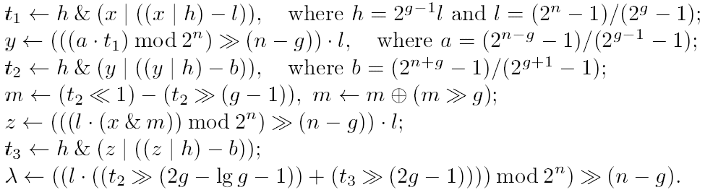
msb(x) in O(1) steps using 5 multiplications
[M.L. Fredman, D.E. Willard, Surpassing the information-theoretic bound with fusion trees,
Journal of Computer and System Sciences 47 (3): 424–436, 1993]
Word size n = g∙g, g a power of 2
Notes:
Page 22, n=g*g, g is a power of 2.
Not of practical interest
Intel 386 and later: Hardware support for MSB by the BSR instruction (Bit Scan Reverse)
LSB = Bit Scan Forward

Slide 3
RAM model (Random Access Machine)
w bits
CPU, O(1) registers
0 | 010100111010101
1 | 001010101010111
2 | 110101010101001
3 | 111010100101010
4 | 110110101010101
. | 111100011110101
. | 111100011111101
 | 111010101010101
 | 111010100101010
 | 110110101010101
 | 111100010000101
 | 111010100101010
 | 110110101010101
 | 100010011110101
 | 000000011111101
 | 100010011110101
 | 000000011111101
 | 000011111111101
 | 111111111111111
OR
-
XOR
write
shift-left
+
*
shift-right
read
Memory, infinite
NOT
AND
not an AC⁰ operation
# reads
Complexity = + # writes
+ # instructions performed
Notes:
AC0 = circuits of depth O(1) and polynomial size, with unlimited-fanin AND gates and OR gates.

Slide 4
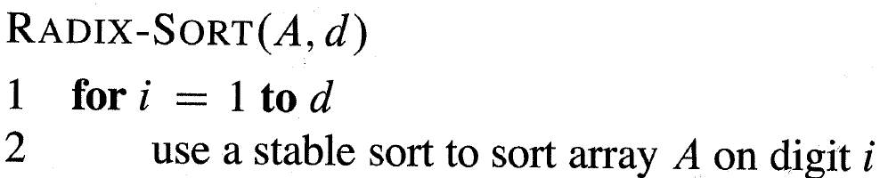
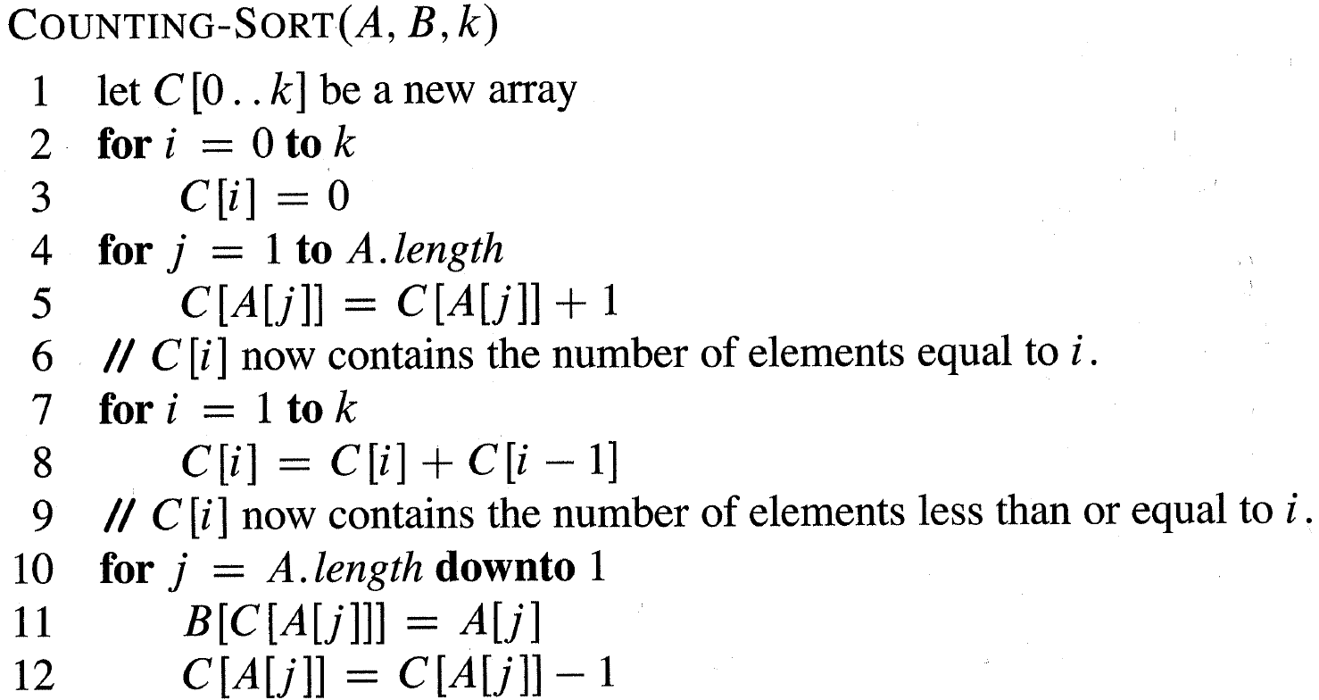
w/log n x Counting-Sort
= O(n∙w/log n)
w bits
Radix Sort
1 | 010100111010101
2 | 001010101010111
3 | 110101010101001
4 | 111010100101010
. | 110110101010101
. | 111100011110101
 | 111100011111101
 | 111010101010101
 | 111010100101010
 | 110110101010101
 | 111100010000101
 | 111010100101010
 | 110110101010101
n | 100010011110101
 | 000000000000000
 | 000000000000000
 | 000000000000000
 | 000000000000000
 | 000000000000000
GOAL: Design algorithms with complexity independent of w (trans-dichotomous)
[M.L. Fredman, D.E. Willard, Surpassing the information-theoretic bound with fusion trees, Journal of Computer and System Sciences 47 (3): 424–436, 1993]
[Cormen et al. 2009]

Slide 5
Sorting
Comparison O(n∙log n)
Radix-Sort O(n∙w/log n)
[KR83] O(n∙log(w/log n))
[T96] O(n∙loglog n)
[HT02] O(n∙√loglog n) exp.
[AHNR95] O(n) exp., w ≥ log^{2+ε} n
[BBN14] O(n) exp., w ≥ log² n⋅loglog n
[D. Kirkpatrick, S. Reisch, Upper bounds for sorting integers on random access machines. Theoretical Computer Science 28(3), 1983]
[M. Thorup, On RAM Priority Queues. ACM-SIAM Symposium on Discrete Algorithms, 59-67, 1996]
[Y. Han, M. Thorup, Integer Sorting in O(n √log log n) Expected Time and Linear Space, IEEE Foundations of Computer Science, 135-144, 2002]
[A. Andersson, T. Hagerup, S. Nilsson, R. Raman: Sorting in linear time? ACM Symposium on Theory of Computing, 427-436, 1995]
[D. Belazzougu, G. S. Brodal, J. A. S. Nielsen, Expected Linear Time Sorting for Word Size Ω(log² n⋅log log n), Scandinavian Workshop on Algorithm Theory, 26-37, 2014]
Priority queues (Insert/DeleteMin)
Comparison O(log n)
[T96] O(loglog n)
[HT02,T07] O(√loglog n) exp.
[M. Thorup, On RAM Priority Queues. ACM-SIAM Symposium on Discrete Algorithms, 59-67, 1996]
[Y. Han, M. Thorup, Integer Sorting in O(n √log log n) Expected Time and Linear Space, IEEE Foundations of Computer Science, 135-144, 2002]
[Mikkel Thorup, Equivalence between priority queues and sorting, J. ACM 54(6), 2007]

Slide 6
Dynamic predecessor searching (w dependent)
[vKZ77] O(log w)
[BF02] O(log w/loglog w) (static, space n^{O(1)})
O(log w/loglog w∙loglog n) (dynamic)
[P. van Emde Boas, R. Kaas, and E. Zijlstra, Design and Implementation of an Efficient Priority Queue, Mathematical Systems Theory 10, 99-127, 1977]
[P. Beame, F.E. Fich, Optimal Bounds for the Predecessor Problem and Related Problems. J. Comput. Syst. Sci. 65(1): 38-72, 2002]
[M. Patrascu, M. Thorup, Time-space trade-offs for predecessor search, ACM Symposium on Theory of Computing, 232-240, 2006]
Dynamic predecessor searching (w independent)
Comparison O(log n)
[FW93] O(log n/loglog n)
[AT07] O(√log n/loglog n)
[M.L. Fredman, D.E. Willard, Surpassing the information-theoretic bound with fusion trees, Journal of Computer and System Sciences 47 (3): 424–436, 1993]
[A. Andersson, M. Thorup, Dynamic ordered sets with exponential search trees. J. ACM 54(3): 13, 2007]
Notes:
van Emde Boas optimal wrt O(n) space solutions, due to Patrascu & Thorup

Slide 7
Sorting two elements in one word...
...without comparisons
X
Y
test bit
0 | 0 | 1 | 0 | 1 | 0 | 1 | 0 | 0 | 0 | 1 | 1 | 1 | 0 | 0 | 1
w bits

Slide 8
Finding minimum of k elements in one word...
...without comparisons
0 | x₁ | 0 | x₂ | 0 | x₃ | 0 | x₄
w bits
0 | 0 0 0 0 0 0 0 | 0 | 0 0 0 0 0 0 0 | 0 | 0 0 0 0 0 0 0 | 0 | min(x₁...x₄)
Searching a sorted set...

Slide 9
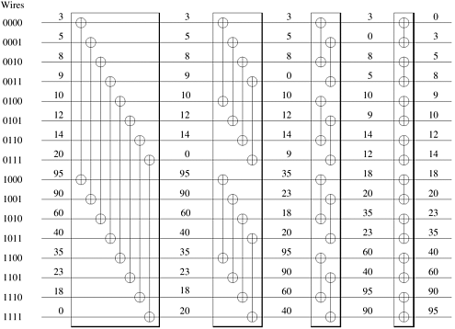
Batcher’s bitonic merger
[K.E. Batcher, Sorting Networks and Their Applications, AFIPS Spring Joint Computing Conference 1968: 307-314]
[S. Albers, T. Hagerup, Improved Parallel Integer Sorting without Concurrent Writing, ACM-SIAM Symposium on Discrete Algorithms, 463-472, 1992]
word implementation, O(log #elements) operations
increasing
sequence
decreasing
sequence
Round 1 Round 2 Round 3 Round 4
Remark: Sorting networks recently revived interest for GPU sorting
Notes:
Merging 16 values

Slide 10
van Emde Boas (the idea in the static case)
[P. van Emde Boas, R. Kaas, and E. Zijlstra, Design and Implementation of an Efficient Priority Queue, Mathematical Systems Theory 10, 99-127, 1977]
min,max
0,13
0,2
13,13
0,2
13,13
0,0
2,2
13,13
2,2
13,13
0,0
0 | 1 | 2 | 3 | 4 | 5 | 6 | 7 | 8 | 9 | 10 | 11 | 12 | 13 | 14 | 15
Universe U ≤ 2^{w}
Predecessor search = find nearest yellow ancestor = binary search on path O(loglog U)
Space O(U) ☹
Notes:
Predecessor : Find first ancestor with min smaller than search key. Answer = max of left child

Slide 11
van Emde Boas (addressing)
[P. van Emde Boas, R. Kaas, and E. Zijlstra, Design and Implementation of an Efficient Priority Queue, Mathematical Systems Theory 10, 99-127, 1977]
min,max
0,13
array indexing roots by msb bits
0,2
13,13
0,2
00₂
01₂
10₂
11₂
13,13
0,0
2,2
13,13
2,2
13,13
0,0
0 | 1 | 2 | 3 | 4 | 5 | 6 | 7 | 8 | 9 | 10 | 11 | 12 | 13 | 14 | 15
Universe U ≤ 2^{w}

Slide 12
van Emde Boas (dynamic)
[P. van Emde Boas, R. Kaas, and E. Zijlstra, Design and Implementation of an Efficient Priority Queue, Mathematical Systems Theory 10, 99-127, 1977]
1 recursive top-structure and √U bottom structures
of the most and least significant log U/2 bits
Keep min & max outside structure ⇒ 1 recursive call
O(loglog U)
search & update
min=0, max=13
9 = 2 ∙ 4 + 1
00₂
01₂
10₂
11₂
Notes:
Gudmund’s note on vEB

Slide 13
van Emde Boas (pseudo code)
[P. van Emde Boas, R. Kaas, and E. Zijlstra, Design and Implementation of an Efficient Priority Queue, Mathematical Systems Theory 10, 99-127, 1977]
succ(i)
{ i = a√n + b }
if i > max then return +∞
if i ≤ min then return min
if size ≤ 2 then return max
if bottom[a]. size > 0 and bottom[a].max ≥ b then
return a√n + bottom[a].succ(b)
else if top.max ≤ a then return max
c := top.succ(a + 1)
return c√n + bottom[c].min
insert(i)
if size = 0 then max := min := i
if size = 1 then
if i < min then min := i else max := i
if size ≥ 2 then
if i < min then swap(i, min)
if i > max then swap(i, max)
{ i = a√n + b }
if bottom[a].size = 0 then top.insert(a)
bottom[a].insert(b)
size := size + 1
delete(i)
if size = 2 then
if i = max then max := min else min := max
if size > 2 then
if i = min then i := min := top.min ∙ √n + bottom[top.min].min
else if i = max then i := max := top.max ∙ √n + bottom[top.max].max
{ i = a√n + b }
bottom[a].delete(b)
if bottom[a].size = 0 then top.delete(a)
size := size – 1
O(loglog U)

Slide 14
van Emde Boas (linear space)
[P. van Emde Boas, R. Kaas, and E. Zijlstra, Design and Implementation of an Efficient Priority Queue, Mathematical Systems Theory 10, 99-127, 1977]
[Dan E. Willard, Log-logarithmic worst-case range queries are possible in space Θ(N), Information Processing Letters 17(2): 81–84, 1983]
min=0, max=13
9 = 2 ∙ 4 + 1
00₂
01₂
10₂
11₂
Buckets = lists of size O(loglog U), store only bucket minimum in vEB
(Dynamic perfect) Hashing to store all O(n) non-zero nodes of vEB
O(n) space, O(loglog U) search

Slide 15
O(n∙loglog n) Sorting
[M. Thorup, On RAM Priority Queues. ACM-SIAM Symposium on Discrete Algorithms, 59-67, 1996]
loglog n recursive levels of vEB
⇒ bottom of recursion log U / log n bit elements
subproblems of k elements stored in k/log n words
⇒ mergesort O(k ∙ log k ∙ loglog n / log n)
merge-sort
merging
2 words
#elements
per word
O(loglog n) priority queue
[M. Thorup, On RAM Priority Queues. ACM-SIAM Symposium on Discrete Algorithms, 59-67, 1996]
vEB
≤ log n min in single word
Sorted lists of size 2^{i} in 2^{i} /w words

Slide 16
O(√log n) Dynamic predecessor searching
[Arne Andersson, Sublogarithmic Searching Without Multiplications. IEEE Foundations of Computer Science, 655-663, 1995]
[Arne Andersson, Mikkel Thorup, Dynamic Ordered Sets with Exponential Search Trees, J. ACM 54(3): 13, 2007]
vEB - √log n recursive levels
w / 2^{√log n} bit elements
packed B-tree of degree Δ= 2^{√log n}
and height log n / log Δ = √log n
O(1) time navigation at node
...
...
...
degree Δ
search keys sorted in one word
16

Slide 17
Sorting in O(n) time ?

Slide 18
Dynamic perfect hashing
[Michael L. Fredman, János Komlós, Endre Szemerédi, Storing a Sparse Table with O(1) Worst Case Access Time, J. ACM 31(3): 538-544, 1984]
[Martin Dietzfelbinger, Anna R. Karlin, Kurt Mehlhorn, Friedhelm Meyer auf der Heide, Hans Rohnert, Robert Endre Tarjan,
Dynamic Perfect Hashing: Upper and Lower Bounds, SIAM J. Computing 23(4): 738-761, 1994]
x
h(x)
Prime p ≥ U (=2^{w})
H = { h_{k} | 0<k<p ∧ h_{k}(x) = k⋅x mod p }
Pr[ h(x)=h(y) ] = 1/table-size
E[ ∑_{i}|B_{i}|² ] = O(n²/table-size)
1 | 2 | 3 |  | i |  | … |  | ∼n
h_{i}(x)
1 | 2 | 3 | … | ∼|B_{i}|²
 |  | x
− pr. Ω(1) no collision in bucket
no collisions
− pr. Ω(1) total bucket space O(n)
2-level hashing of set S of size n
Random hash functions from H: h, h₁, h₂, … (mod table size)
Bucket B_{i} = { x ∈ S | h(x) = i }
Rehash:
  whole table if ∑_{i}|B_{i}|² ≥ c⋅n → new table size n
  bucket if collision → new bucket size |B_{i}|²
Search O(1) worst-case & updates O(1) expected amortized
− all hash functions new
− one new h_{i}
Notes:
Analysis : doubling phases; assume knowledge about all elements at the end of the phase; probability p>0 for success for each random choice; expected #retrys O(1), each of linear cost

