Slide 1

Searching in Trees
Gerth Stølting Brodal
Aarhus University
Workshop on The Art of Data Structures in honor of Prof. Athanasios Tsakalidis, Patras, Greece, November 7, 2017
Notes:
Talk duration: 45 min
finger search + applications

Slide 2




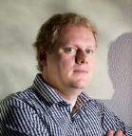

Konstantinos Tsakalidis
PhD, Aarhus 2011
Kurt Mehlhorn
PhD, Cornell 1974
Athanasios K. Tsakalidis
PhD, Saarbrücken 1983
Konstantinos Tsichlas
PhD, Patras 2003
2 papers
Konstantinos Mampentzidis
Diploma, Thessaloniki 2013
PhD, Aarhus exp. 2019
Erik Meineche Schmidt
PhD, Cornell 1977
Gerth Stølting Brodal
PhD, Aarhus 1997
Notes:
Athanasios visited MADALGO in 2007
Gerth visited Patras in October 2001
Joint publications:
Brodal, Lagogiannis, Makris, AK. Tsakalidis, Tsichlas:
Optimal finger search trees in the pointer machine. STOC 02 /JCSS 03
STOC 2002: 583-591
Brodal, Makris, Sioutas, A.K. Tsakalidis, Tsichlas:
Optimal Solutions for the Temporal Precedence Problem. Algorithmica 33(4): 494-510 (2002)

Slide 3
♣♦
♥♠
Notes:
Free interpretation over the paper AVL –Trees for Localized Search (ICALP 1984)

Slide 4
11
23
17
43
♣♦
♥♠
2
3
5
3
37
13
41
17
43
47
5
7
19
23
11
29
31
7
2
19
41
29
31
37
13
47

Slide 5
11
23
17
43
2
3
2
3
5
5
7
11
13
17
19
23
29
31
37
41
43
47
7
19
41
29
31
37
13
47

Slide 6
2
♣♦
♥♠
3
♣♦
♥♠
5
♣♦
♥♠
7
♣♦
♥♠
11
♣♦
♥♠
13
♣♦
♥♠
17
♣♦
♥♠
19
♣♦
♥♠
23
♣♦
♥♠
29
♣♦
♥♠
31
♣♦
♥♠
37
♣♦
♥♠
41
♣♦
♥♠
43
♣♦
♥♠
47
♣♦
♥♠
Notes:
Flip cards

Slide 7
42 ?
n
2
♣♦
♥♠
3
♣♦
♥♠
5
♣♦
♥♠
7
♣♦
♥♠
11
♣♦
♥♠
13
♣♦
♥♠
17
♣♦
♥♠
19
♣♦
♥♠
23
♣♦
♥♠
29
♣♦
♥♠
31
♣♦
♥♠
37
♣♦
♥♠
41
♣♦
♥♠
43
♣♦
♥♠
47
♣♦
♥♠
Binary search 1 + ⎣log₂ n⎦ comparisons

Slide 8
♣♦
♥♠
♣♦
♥♠
♣♦
♥♠
♣♦
♥♠
♣♦
♥♠
♣♦
♥♠
♣♦
♥♠
19
♣♦
♥♠
♣♦
♥♠
♣♦
♥♠
37
41
43
♣♦
♥♠
2
♣♦
♥♠
3
♣♦
♥♠
5
♣♦
♥♠
7
♣♦
♥♠
11
♣♦
♥♠
13
♣♦
♥♠
17
♣♦
♥♠
19
19
23
♣♦
♥♠
29
♣♦
♥♠
31
♣♦
♥♠
37
37
41
41
43
43
47
♣♦
♥♠
2
3
5
7
11
13
17
19
23
29
31
37
41
43
47

Slide 9
2
3
3
5
7
7
11
13
13
17
19
19
23
29
29
31
37
37
41
43
43
47

Slide 10

42 ?
19
7
37
3
13
29
43
2
3
5
7
11
13
17
19
23
29
31
37
41
43
47

Slide 11
Binary search 41 ?
2
♣♦
♥♠
3
♣♦
♥♠
41
♣♦
♥♠
31
♣♦
♥♠
11
♣♦
♥♠
13
♣♦
♥♠
7
♣♦
♥♠
17
♣♦
♥♠
23
♣♦
♥♠
47
♣♦
♥♠
19
♣♦
♥♠
43
♣♦
♥♠
5
♣♦
♥♠
29
♣♦
♥♠
37
♣♦
♥♠
Forgot to sort...
Notes:
Let us repeat – but now cards not sorted!

Slide 12
41
Random keys
17
31
43
3
13
47
29
2
41
11
7
23
19
5
37
not reachable

Slide 13
Reachable nodes
17
useful
useful
31
43
useful
3
13
47
29
2
41
11
7
23
19
5
37

Slide 14
Reachable nodes – analysis
Pr[ v_{i} useful ] = |L_{i}| / Σ_{j}|L_{j}|
E[ # useful nodes at level ] = Σ_{i}( |L_{i}| / Σ_{j}|L_{j}| ) = 1
E[ # useful nodes in tree ] = height - 1
E[ # reachable nodes in tree ] ≤ height² = O(log² n) □
useful
17
useful
31
43
]-∞,17[
∅
]17,43[
]43,∞[
# useful nodes ?
v₁
v₂
v₃
v₄
L₁ = { 2,3,4,5,11 }
L₂ = ∅
L₃ = { 19,23,29,37,41 }
L₄ = { 47 }

Slide 15
Fun-Sort
Uses repeated searches in an unsorted array to sort the array in Θ(n² log n) time.
[Biedl, Chan, Demaine, Fleischer, Golin, King, Munro 2001]
Notes:
HKUST Theoretical Computer Science Center Research Report HKUST-TCSC-2001-03
(Paper also containts dumb-Sort and not-so-Dumb-Sort)

Slide 16
42 ?
19
7
37
3
13
29
43
2
3
5
7
11
13
17
19
23
29
31
37
41
43
47
Notes:
Return to binary search. Standard binary search starts at the root.

Slide 17
14 ?
19
7
37
3
13
29
43
2
3
5
7
11
13
17
19
23
29
31
37
41
43
47
d
2+2⎣log₂ d⎦ comparisons

Slide 18
14 ?
binary search
1
2
4
2
♣♦
♥♠
3
♣♦
♥♠
5
♣♦
♥♠
7
♣♦
♥♠
11
♣♦
♥♠
13
♣♦
♥♠
17
♣♦
♥♠
19
♣♦
♥♠
23
♣♦
♥♠
29
♣♦
♥♠
31
♣♦
♥♠
37
♣♦
♥♠
41
♣♦
♥♠
43
♣♦
♥♠
47
♣♦
♥♠
d
Exponential search 2+ ⎣log₂ d⎦ comparisons
2

Slide 19
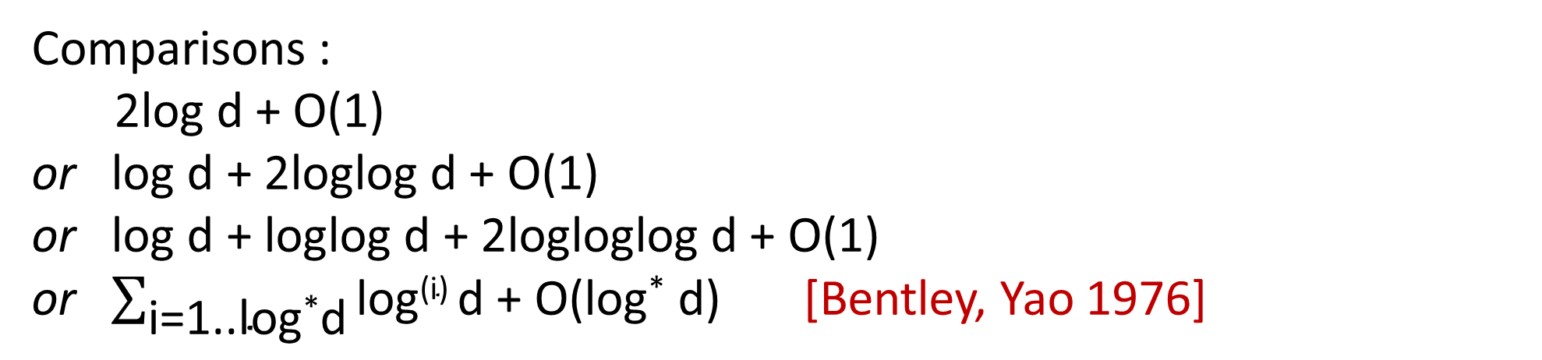
Exponential search revisited
log log log d
sorted
loglog d
log log d
log d
log d
Comparisons :
2log d + O(1)
or log d + 2loglog d + O(1)
or log d + loglog d + 2logloglog d + O(1)
or $\sum_{\text{i}\text{=1..}\text{log}\text{∗}\text{d}}{\text{log}\text{(}\text{i}\text{) }\text{d}}$ + O(log* d) [Bentley, Yao 1976]
log d
d
Notes:
Bentley and Yao also proved a matching lower bound except a ”-O(log* d)

Slide 20
Random search tree
2
3
5
7
11
13
17
19
23
29
31
37
41
43
47
2
3
5
7
11
13
13
17
19
19
23
29
29
31
37
41
43
43
47

Slide 21
Random search tree
41
3
47
2
5
43
19
13
29
7
17
23
37
11
31
Expected depth O(log n)

Slide 22
32 ?
41
3
47
2
5
43
19
13
29
7
17
23
37
11
31
[Seidel, Aragon 1989]
Expected time O(log d)

Slide 23
O(log n)
Worst-case
19
7
37
3
13
29
43
2
5
11
17
23
31
41
47
24 ?

Slide 24
Level links
19
7
37
3
13
29
43
2
3
5
7
11
13
17
19
23
29
31
37
41
43
47
32 ?
O(log d)

Slide 25
Dynamic finger search trees
Level-linked (2,4)-trees support
Finger search in worst-case O(log d) time
Insert/delete in amortized O(1) time but worst-case O(log n) time
[Huddleston and Mehlhorn 1982]
19
7
37
3
13
29
43
2
3
5
7
11
13
17
19
23
29
31
37
41
43
47

Slide 26
AVL-trees with one finger
Finger search and insert/delete
in worst-case O(log d) time
[Taskalidis 1984]
23
7
3
13
2
5
11
17
19
Notes:
Idea: Have regularity constraint on leftmost path, order nodes into blocks, allow height difference TWO on leftmost path

Slide 27
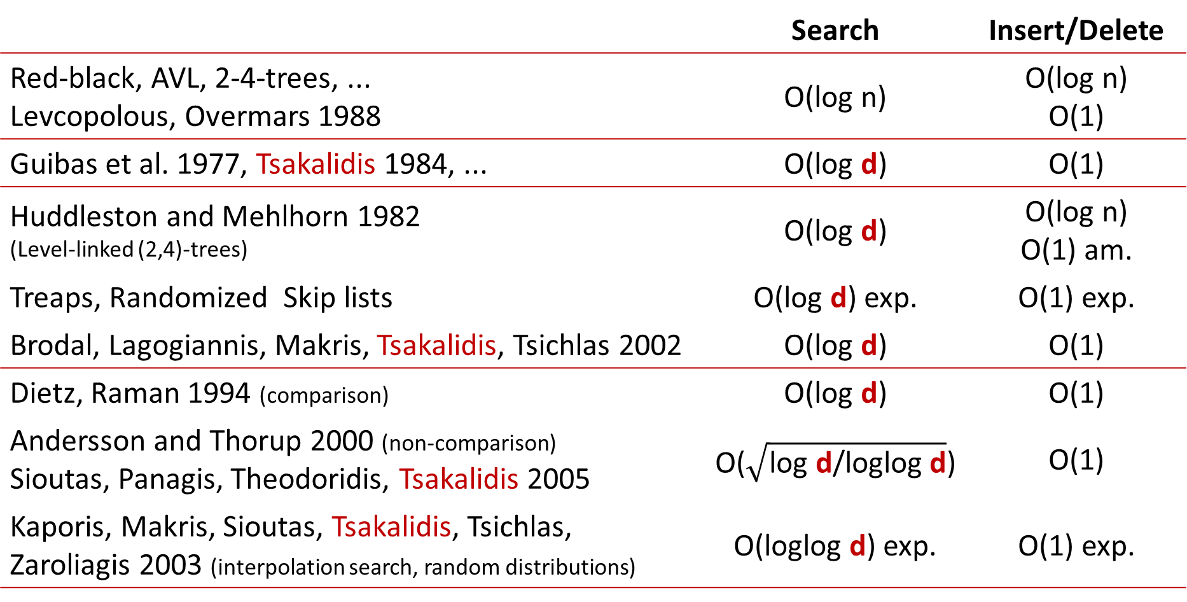
Dynamic finger search
 | Search | Insert/Delete
Red-black, AVL, 2-4-trees, ... Levcopolous, Overmars 1988 | O(log n) | O(log n) O(1)
Guibas et al. 1977, Tsakalidis 1984, ... | O(log d) | O(1)
Huddleston and Mehlhorn 1982 (Level-linked (2,4)-trees) | O(log d) | O(log n) O(1) am.
Treaps, Randomized Skip lists | O(log d) exp. | O(1) exp.
Brodal, Lagogiannis, Makris, Tsakalidis, Tsichlas 2002 | O(log d) | O(1)
Dietz, Raman 1994 (comparison) | O(log d) | O(1)
Andersson and Thorup 2000 (non-comparison) Sioutas, Panagis, Theodoridis, Tsakalidis 2005 | O($\sqrt{\text{log} \text{d}\text{/}\text{loglog} \text{d}}$) | O(1)
Kaporis, Makris, Sioutas, Tsakalidis, Tsichlas, Zaroliagis 2003 (interpolation search, random distributions) | O(loglog d) exp. | O(1) exp.
Root
finger
O(1)
Arbitrary
RAM, Arbitrary
Notes:
Tsakalidis 1984 – AVL trees.
O(1) fingers allow fingers to be moved in O(log d) time
RAM 2005 Tsakalidis: Simplified, but either uses randomization or 1 finger

Slide 28
Application : Binary merging
[Huddleston, Mehlhorn 1982]
Merging sorted lists L₁ and L₂ represented by finger search trees
Merging all leaf lists in an
arbitrary binary tree O(n∙log n)
Proof Induction O(log n!)
O(log n₁! + log n₂! + n₁∙log ((n₁+n₂)/n₁))
= O(log n₁! + log n₂! + log ( ))
= O(log (n₁! ⋅ n₂! ⋅ ( ))) = O(log (n₁+n₂)!)
repeated
insertion
L₁
L₂
d_{i}
1 2 3 4 5 6 7 8 9
1 2 3 4 5 7
1 2 3 7
4 5
8
n₂
n₁
1
4
5
9
6
n₁+n₂
n₁
2
n₁+n₂
n₁
7
3

Slide 29
Application : Maximal pairs with bounded gap
[Brodal, Lyngsø, Pedersen, Stoye 1999]
left maximal ≠
≠ right maximal
ABCDABDBADAADDABDBACABA
P
gap
∈[low,high]
P
O(n∙log n + k)
Build suffix tree (ST) & make it binary
Create leaf lists at each node
Right-maximal pairs = ST nodes
Find maximal pairs = finger search at ST nodes
Notes:
CPM 1999
Left maximal =block elements in the leaf lists by color (= character to the left of index), such that blocks of identical colored pairs can be skipped in O(1) time

Slide 30
Athanasios K. Tsakalidis & finger search
1984 – 1985 – 1986 – 2002 – 2003 – 2005 – 2009 – 2013
Thank you
RAM interpolation finger search (journal)
AVL amortized O(1) deletions
AVL amortized O(1) insertions
Optimal dynamic pointer based
RAM interpolation finger search
RAM simplified randomized
AVL + 1 finger
Summary

Slide 31
Search trees with O(1) time insertions
n/log² n leafs
⋅⋅⋅
degree Θ(log n)
Top part worst-case O(log n) update
2-level buckets O(log² n) size
Incremental splitting of buckets ⇒ Worst-case O(1) insertions
Split largest bucket
[Levcopoulos, Overmars 1988]
Notes:
Incremental splitting = O(log n) time for top insertions
Splitting of buffers O(log n) time
Zeroing game gets a factor O(log n) overhead
Zeroing game is studied in “Maintaining order in a list paper”, Dietz & Sleator 1987

Slide 32
Zeroing game
[P. Dietz, D. Sleator, 1987]
Variables x₁,…,x_{n} ≥ 0 (initially x_{i} = 0)
Players Z and A alternate to take turns
  Z: Select j where a_{j} = max_{i} x_{i}, set x_{j} := 0
  A: Select a₁,…,a_{n} ≥ 0 and ∑_{i} a_{i} = 1, set x_{i} += a_{i}
x₁
x₂
x₃ ∙ ∙ ∙ ∙
x_{n}
Theorem ∀i : x_{i} ≤ H_{n-1} + 1 ≤ ln n + 2
Notes:
Trivial sum xi≤n – simple induction, either xj≤1 and all xi≤1 or xj>1 and Z decreases by more than A increases
Halving/splitting game: consider yi=max (0,xi-(H_(n-1) -1)) => game on xi’s is a zeroing game on yi

