Slide 1
Binære Tællere
Gerth Stølting Brodal (Aarhus Universitet)
Mark Greve (Aarhus Universitet)
Vineet Pandey (BITS Pilani, Indien)
S. Srinivasa Rao (Seoul, Syd Korea)
Verdens Kedeligste Foredrag, Tågekammeret, Aarhus Universitet, 2. marts 2011
Notes:
20 min oplæg

Slide 2
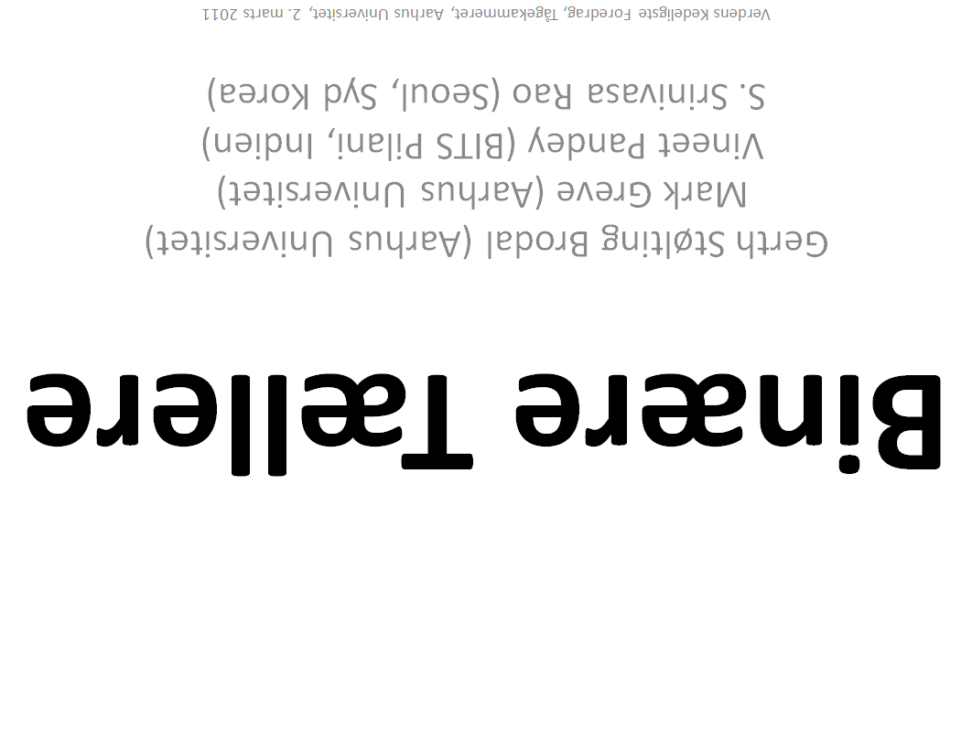

Slide 3
0

Slide 4
1

Slide 5
10

Slide 6
11

Slide 7
100

Slide 8
101

Slide 9
110

Slide 10
111

Slide 11
1000

Slide 12
1001

Slide 13
1010

Slide 14
1011

Slide 15
1100

Slide 16
1101

Slide 17
1110

Slide 18
1111

Slide 19
0000
- vi tæller modulo 10000₂ = 16₁₀

Slide 20
1011
1∙2³+ 0∙2²+ 1∙2¹+ 1∙2⁰ = 8+2+1 = 11₁₀

Slide 21
Decimal | Binær
0 | 0000
1 | 0001
2 | 0010
3 | 0011
4 | 0100
5 | 0101
6 | 0110
7 | 0111
8 | 1000
9 | 1001
10 | 1010
11 | 1011
12 | 1100
13 | 1101
14 | 1110
15 | 1111
0 | 0000
Decimal | Binær
0 | 0000
1 | 0001
2 | 0010
3 | 0011
4 | 0100
5 | 0101
6 | 0110
7 | 0111
8 | 1000
9 | 1001
10 | 1010
11 | 1011
12 | 1100
13 | 1101
14 | 1110
15 | 1111
0 | 0000
Decimal | Binær
0 | 0000
1 | 0001
2 | 0010
3 | 0011
4 | 0100
5 | 0101
6 | 0110
7 | 0111
8 | 1000
9 | 1001
10 | 1010
11 | 1011
12 | 1100
13 | 1101
14 | 1110
15 | 1111
0 | 0000
Algoritme
b₀
0 1
b₃b₂b₁b₀
---1
b₁
0 1
læser 4 bits
skriver 4 bits
--10
b₂
0 1
-100
b₃
0 1
1000
0000

Slide 22
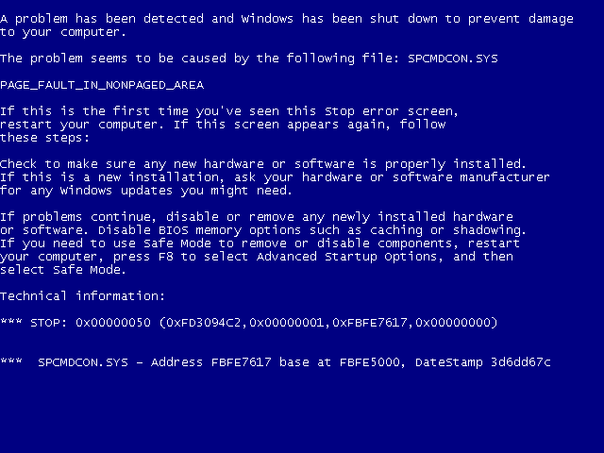
Recovering..........

Slide 23
Decimal | Binær | Spejlet Gray kode
0 | 0000 | 0000
1 | 0001 | 0001
2 | 0010 | 0011
3 | 0011 | 0010
4 | 0100 | 0110
5 | 0101 | 0111
6 | 0110 | 0101
7 | 0111 | 0100
8 | 1000 | 1100
9 | 1001 | 1101
10 | 1010 | 1111
11 | 1011 | 1110
12 | 1100 | 1010
13 | 1101 | 1011
14 | 1110 | 1001
15 | 1111 | 1000
0 | 0000 | 0000
Decimal | Binær | Spejlet Gray kode
0 | 0000 | 0000
1 | 0001 | 0001
2 | 0010 | 0011
3 | 0011 | 0010
4 | 0100 | 0110
5 | 0101 | 0111
6 | 0110 | 0101
7 | 0111 | 0100
8 | 1000 | 1100
9 | 1001 | 1101
10 | 1010 | 1111
11 | 1011 | 1110
12 | 1100 | 1010
13 | 1101 | 1011
14 | 1110 | 1001
15 | 1111 | 1000
0 | 0000 | 0000
"To get the next code, for a code with even parity, flip the rightmost bit. For a code with odd parity, find the rightmost ‘1’ and flip the bit to its left. The only special case is when the last bit b_{n} is the only ‘1’ in the code. This is also the last code in the sequence."
b₃b₂b₁b₀
b₀
0 1
b₁
b₁
0 1
0 1
b₂
b₂
b₂
b₂
0 1
0 1
0 1
0 1
b₃
b₃
b₃
b₃
b₃
b₃
b₃
b₃
0 1
0 1
0 1
0 1
0 1
0 1
0 1
0 1
---1
--1-
-1--
---0
1---
---0
---1
--0-
0---
---0
---1
--0-
---1
--1-
-0--
----0
læser altid 4 bits
skriver altid 1 bit

Slide 24
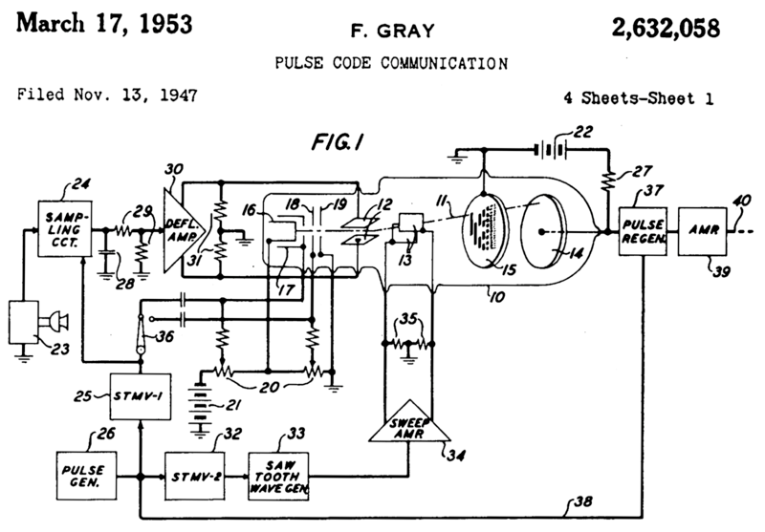
Notes:
Wikipedia:
Reflected binary codes were applied to mathematical puzzles before they became known to engineers. The French engineer Émile Baudot used Gray codes in telegraphy in 1878. He received the French Legion of Honor medal for his work. The Gray code is sometimes attributed, incorrectly,^{[5]} to Elisha Gray (in Principles of Pulse Code Modulation, K. W. Cattermole,^{[6]} for example).
Frank Gray, who became famous for inventing the signaling method that came to be used for compatible color television, invented a method to convert analog signals to reflected binary code groups using vacuum tube-based apparatus. The method and apparatus were patented in 1953 and the name of Gray stuck to the codes. The "PCM tube" apparatus that Gray patented was made by Raymond W. Sears of Bell Labs, working with Gray and William M. Goodall, who credited Gray for the idea of the reflected binary code.
Part of front page of Gray's patent, showing PCM tube (10) with reflected binary code in plate (15)
The use of his eponymous codes that Gray was most interested in was to minimize the effect of error in the conversion of analog signals to digital; his codes are still used today for this purpose, and others.

Slide 25
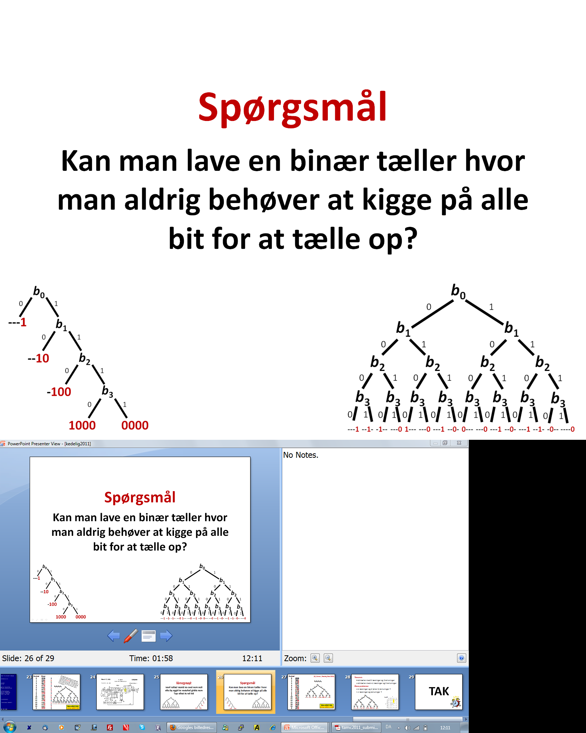
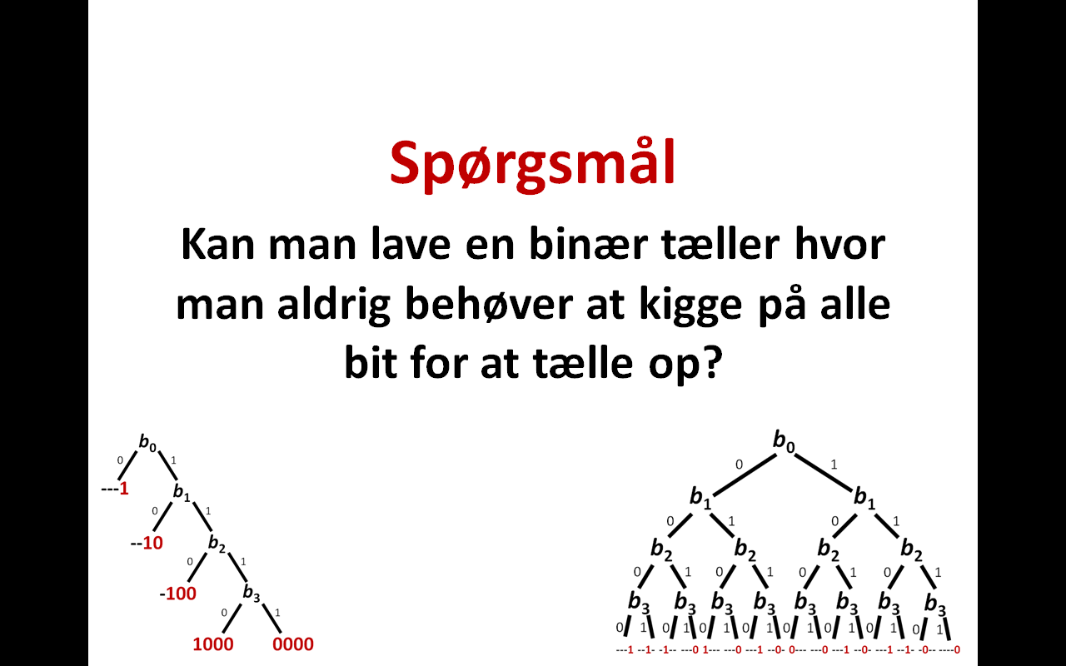

Slide 26
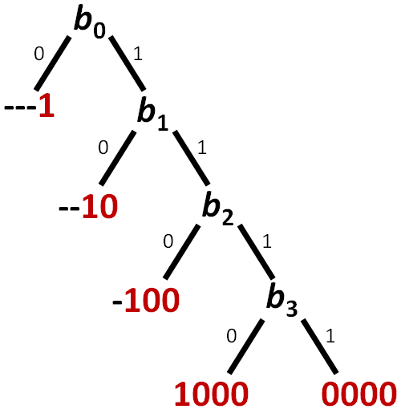
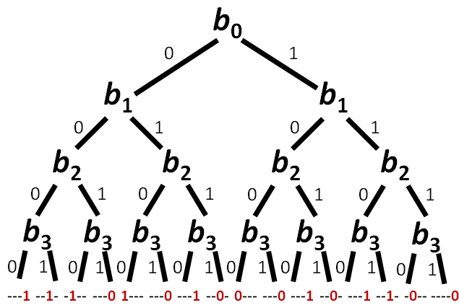
Spørgsmål
Kan man lave en binær tæller hvor man aldrig behøver at kigge på alle bit for at tælle op?

Slide 27
Decimal
0 | 0000
1 | 0001
2 | 0100
3 | 0101
4 | 1101
5 | 1001
6 | 1100
7 | 1110
8 | 0110
9 | 0111
10 | 1111
11 | 1011
12 | 1000
13 | 1010
14 | 0010
15 | 0011
0 | 0000
[B., Greve , Pandey, Rao 2011]
Decimal
0 | 0000
1 | 0001
2 | 0100
3 | 0101
4 | 1101
5 | 1001
6 | 1100
7 | 1110
8 | 0110
9 | 0111
10 | 1111
11 | 1011
12 | 1000
13 | 1010
14 | 0010
15 | 0011
0 | 0000
Decimal
0 | 0000
1 | 0001
2 | 0100
3 | 0101
4 | 1101
5 | 1001
6 | 1100
7 | 1110
8 | 0110
9 | 0111
10 | 1111
11 | 1011
12 | 1000
13 | 1010
14 | 0010
15 | 0011
0 | 0000
b₃b₂b₁b₀
b₀
0 1
b₁
b₂
0 1
0 1
b₃
b₃
b₁
b₃
0 1
0 1
0 1
0 1
---1
--1-
---1
0---
-1-0
--00
1---
-0--
læser altid 3 bits
skriver altid ≤ 2 bits

Slide 28
[B., Greve , Pandey, Rao 2011]
Generalisering til tællere med n bit
b_{n-1} b_{n-2} ∙∙∙ b₆ b₅ b₄ b₃ b₂ b₁ b₀
X
n-4 bit Gray kode
n-4 læsninger
1 skrivning
Y
4 bit
3 læsninger
2 skrivninger
metode Increment(XY)
inc(X)
if (X == 0) inc(Y)
læser altid n-1 bits
skriver altid ≤ 3 bits

Slide 29
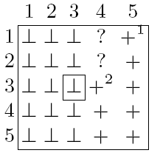
Sætning
4-bit tæller med 3 læsninger og 2 skrivninger
n-bit tæller med n-1 læsninger og 3 skrivninger
Åbne problemer
n-1 læsninger og 2 (eller 1) skrivninger ?
« n læsninger og skrivninger ? [skal mindst læse log₂ n]
b₀
n=5
bit læst
0 1
b₁
b₂
?
?
0 1
0 1
b₃
b₃
b₁
b₃
bit skrevet
0 1
0 1
0 1
0 1
---1
--1-
---1
0---
-1-0
--00
1---
-0--
Notes:
Gray code
Theorem, 2. linie
Box) Brute force disprove

Slide 30

TAK

