Slide 1
Algorithms and Data Structures
Gerth Stølting Brodal
Lars Arge
Computer Science Day, Department of Computer Science, Aarhus University, May 31, 2013
Notes:
15:33
s

Slide 2
May 23 2013
Notes:
Relater til Computational Geometry kurset

Slide 3
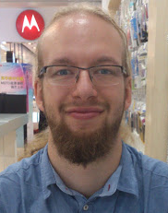
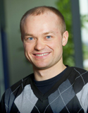
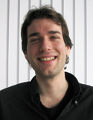
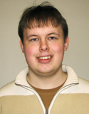
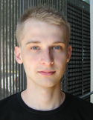
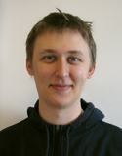
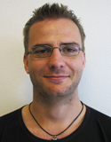
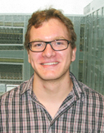
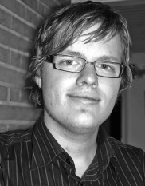
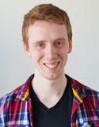
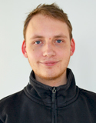
MADALGO – CTIC 6 : 3
Speciale
May 23 2013
PostDoc
Jana
Morten
Daniel
Phd
Darius
Constantinos
Jesper
Jakob
Casper
Morten
Jørgen
Jeppe
Jens
Sarfraz
(PhD)
Else
(Manager)
Gerth
(Lektor)
Peyman
(Adjunkt)
Bryan
(PhD)
Steffen
Allan
(PostDoc)
Jakob
Zhewei
(PostDoc)
Lars
(Professor)
Yungwoo
(PhD)
Mikkel
Notes:
Hvem er vi

Slide 4
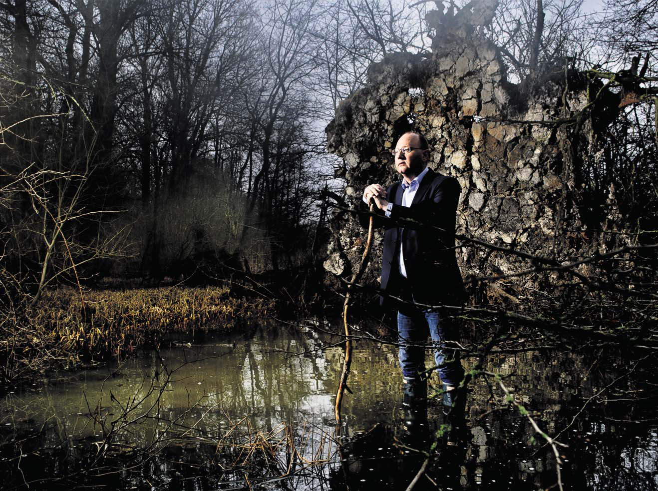
Lars
Water
Else’s
rubber boots

Slide 5
Lars’ house
Brabrand lake
Notes:
Bange for oversvømmelser ;-)

Slide 6
Lars’ house
Notes:
Water flow

Slide 7
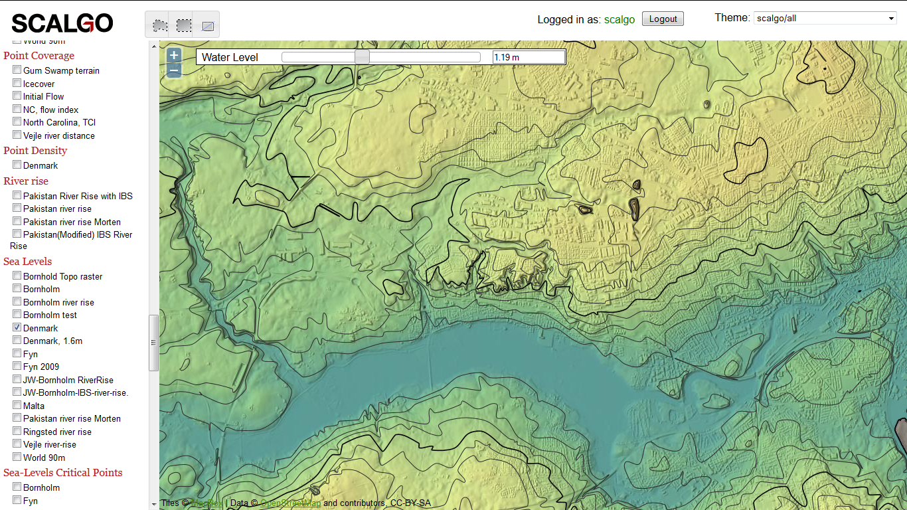
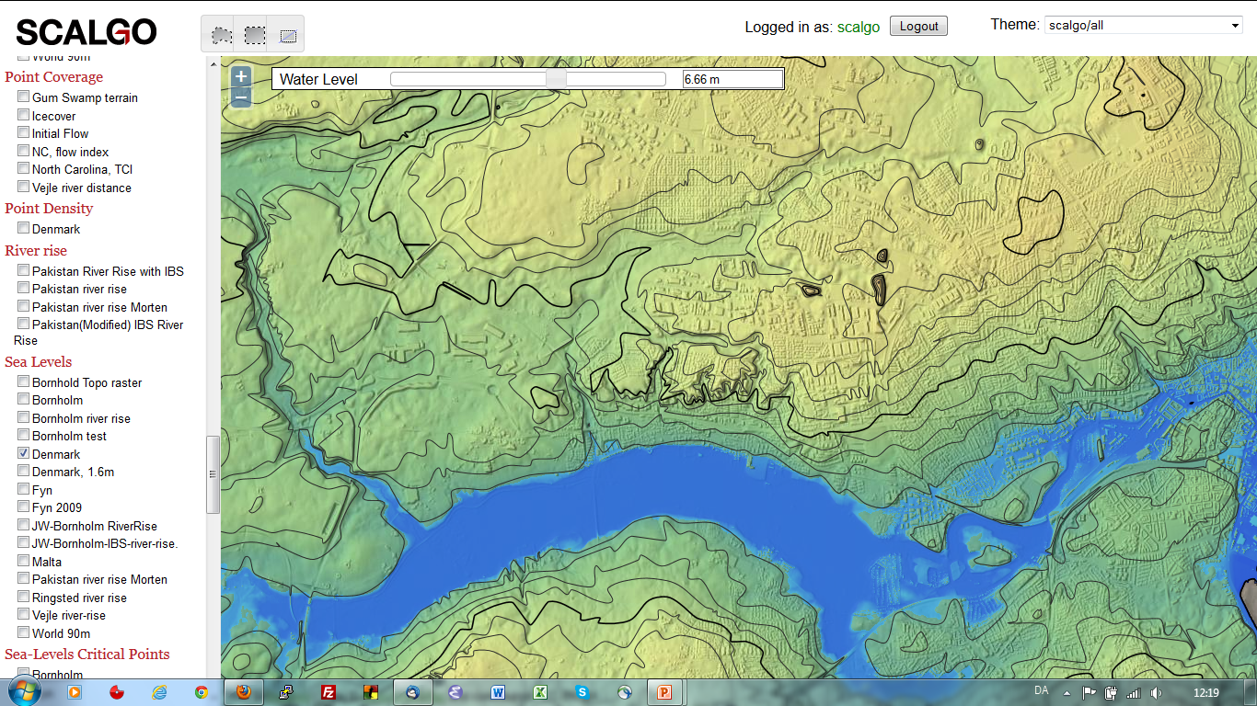
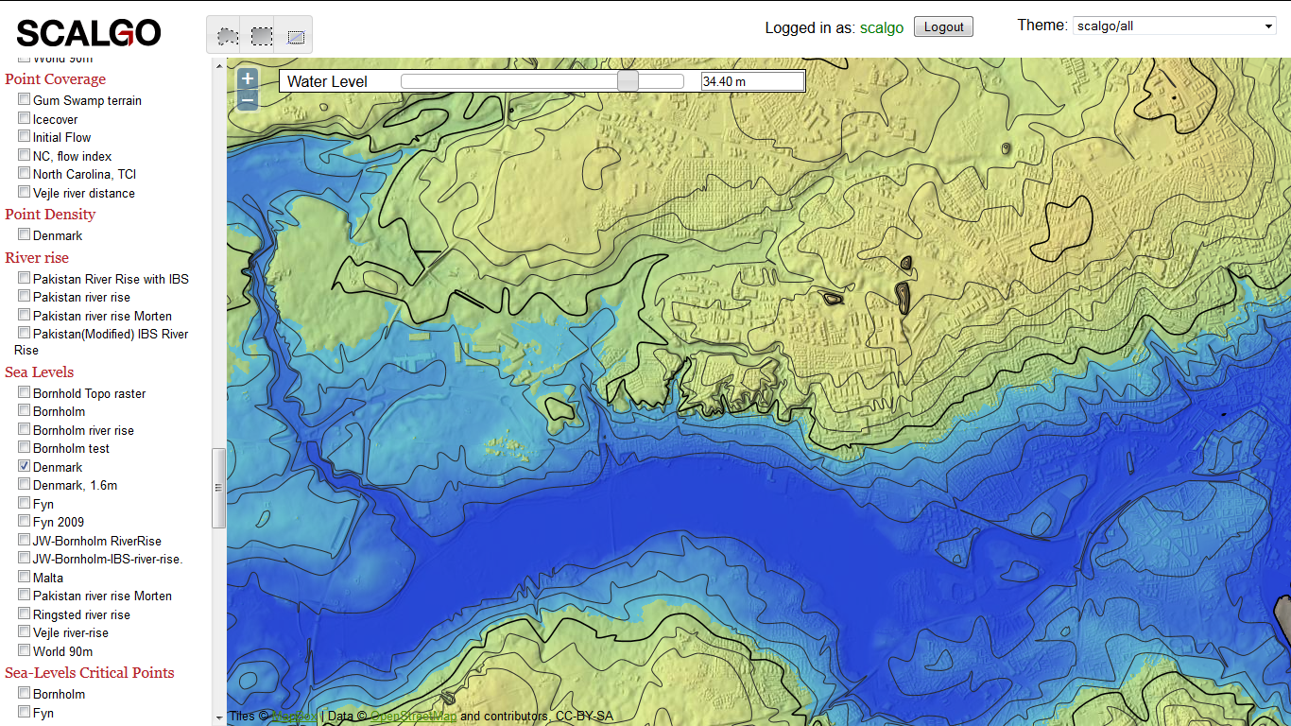
Lars’ house
Notes:
Lars tag: 52 meter

Slide 8
Research
Practical
Algorithmics
Theory
EcoInformatics
BioInformatics
COWI, DES, EIVA, …
Gerth
Lars
Peyman
Commercial
Notes:
Relater til Computational Geometry kurset

Slide 9
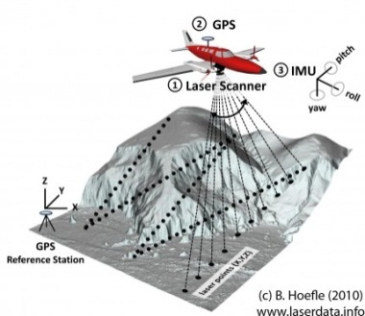
Terrain Research
3
2
4
3
2
4
7
5
8
7
5
8
7
1
9
7
1
9
3
2
4
3
2
4
7
5
8
7
5
8
7
1
9
7
1
9
Height matrix
Terrain model
Notes:
Relater til Computational Geometry course by Peyman Afshani
1TB for Denmar
IO algorithm need – IO course in the fall by Lars Arge

Slide 10
Range Minimum Queries (1D)
1 | 2 | 3 | 4 | 5 | 6 | 7 | 8 | n 9
0.3 | 0.1 | 3.5 | 2.4 | 0.7 | 5.2 | 1.6 | 3.7 | 4.2
RMQ(3,6) = 5
2
0.1
Cartesian tree [Vuillemin 1980]
5
1
5
0.3
0.7
4
7
2.4
1.6
3
6
8
3.5
5.2
3.7
9
4.2
2n bit encoding
2n+o(n) bit encoding
O(1) time queries
[Fischer, Heun 2011]
1 | 0 | 0 | 1 | 1 | 1 | 0 | 0 | 0 | 1 | 1 | 0 | 0 | 1 | 0 | 1 | 0 | 0
2_{L} | 1_{L} | 1_{R} | 2_{R} | 5_{L} | 4_{L} | 3_{L} | 3_{R} | 4_{R} | 5_{R} | 7_{L} | 6_{L} | 6_{R} | 7_{R} | 8_{L} | 8_{R} | 9_{L} | 9_{R}
Notes:
Appear’s in ”Advanced Data Structures” course

Slide 11
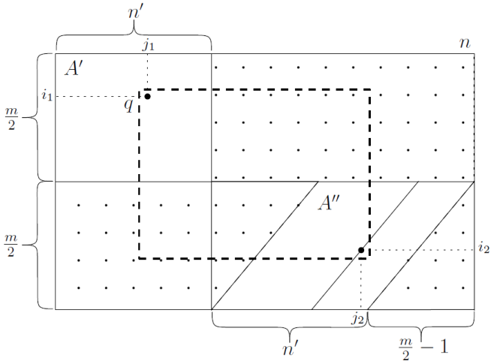
Range Minimum Queries (2D)
 | 1 | 2 | 3 | 4 | n 5
1 | 0.3 | 0.1 | 3.5 | 2.4 | 0.7
2 | 5.2 | 1.6 | 0.6 | 4.2 | 8.7
m 3 | 1.4 | 3.8 | 6.5 | 4.1 | 0.2
 | 1 | 2 | 3 | 4 | n 5
1 | 0.3 | 0.1 | 3.5 | 2.4 | 0.7
2 | 5.2 | 1.6 | 0.6 | 4.2 | 8.7
m 3 | 1.4 | 3.8 | 6.5 | 4.1 | 0.2
 | 1 | 2 | 3 | 4 | n 5
1 | 0.3 | 0.1 | 3.5 | 2.4 | 0.7
2 | 5.2 | 1.6 | 0.6 | 4.2 | 8.7
m 3 | 1.4 | 3.8 | 6.5 | 4.1 | 0.2
 | 1 | 2 | 3 | 4 | n 5
1 | 3 | 1 | 9 | 8 | 5
2 | 13 | 7 | 4 | 12 | 15
m 3 | 6 | 10 | 14 | 11 | 2
Rank matrix
RMQ(2,2,3,4) = (2,3)
nm⋅ ⎡log(nm)⎤ bit encoding
Lower bound: Ω(nm⋅log m)
[Brodal, Davoodi, Rao 2012]
Upper bound: O(nm⋅log m)
[Brodal, Brodnik, Davoodi 2013]
Query time ?
Notes:
Open problem: Space optimal queries, with O(1) query time

Slide 12
Research
Practical
Algorithmics
Theory
EcoInformatics
BioInformatics
COWI, DES, EIVA, …
Gerth
Lars
Peyman
Commercial
Notes:
Relater til Computational Geometry kurset

Slide 13
Thank you
Gerth Stølting Brodal
Lars Arge

