Slide 1

Cache-Oblivious Algorithms
A Unified Approach to Hierarchical Memory Algorithms
Gerth Stølting Brodal
Aarhus University
Current Trends in Algorithms, Complexity Theory, and Cryptography, Tsinghua University, Beijing, China, May 22-27, 2009
Notes:
Bertinoro 06 (girafs)
Oberwolfach 07 (io & cache)
Patras 01 (trees)

Slide 2
Overview
Computer ≠ Unit Cost RAM
Overview of Computer Hardware
A Trivial Program
Hierarchical Memory Models
Basic Algorithmic Results for Hierarchical Memory
The influence of other Chip Technologies
Theory Practice

Slide 3
Computer ≠ Unit Cost RAM

Slide 4
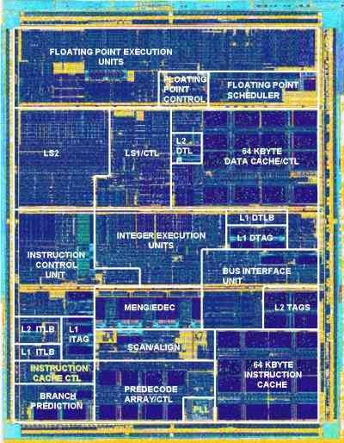
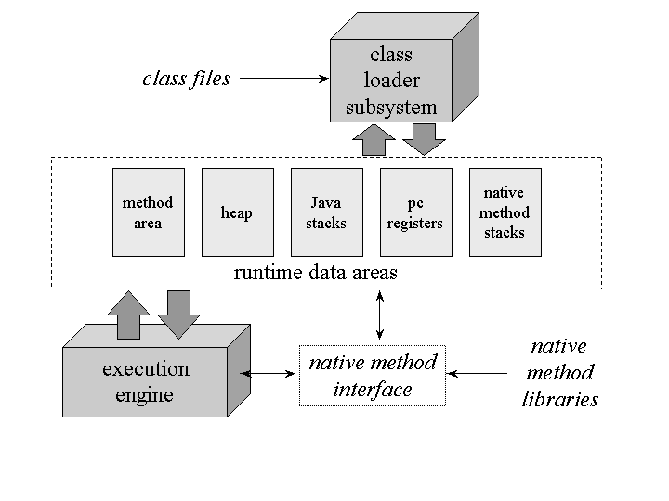
From Algorithmic Idea to Program Execution
Pseudo Code
(Java) Code
Divide and conquer?
…
for each x in m up to middle
add x to left
for each x in m after middle
add x to right
…
…
if ( t1[t1index] <= t2[t2index] )
a[index] = t1[t1index++];
else
a[index] = t2[t2index++];
…
Idea
Compiler
Microcode
Virtual Memory/
TLB
L1, L2,… cache
Pipelining
Branch Prediction
Machine Code
Assembler
(Java) Byte Code
+ Virtual machine
Program
Execution
Notes:
MergeSort pseudo kode + Java uddrag
Billedet er af en Athlon

Slide 5
Computer Hardware

Slide 6

Computer Hardware

Slide 7


Slide 8
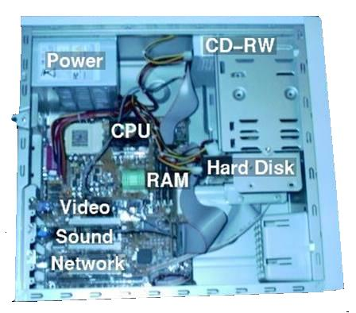
Inside a PC

Slide 9
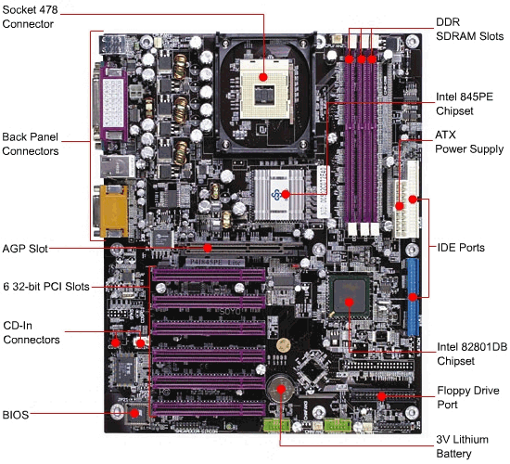
Motherboard

Slide 10
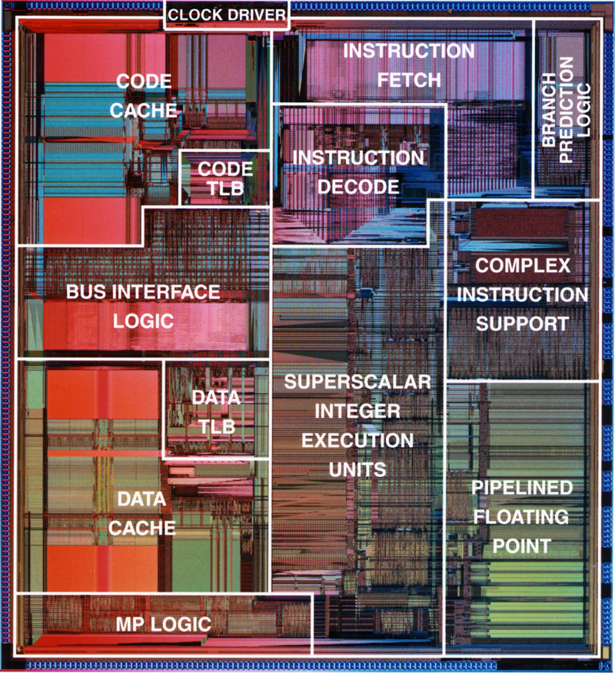
Intel Pentium (1993)

Slide 11
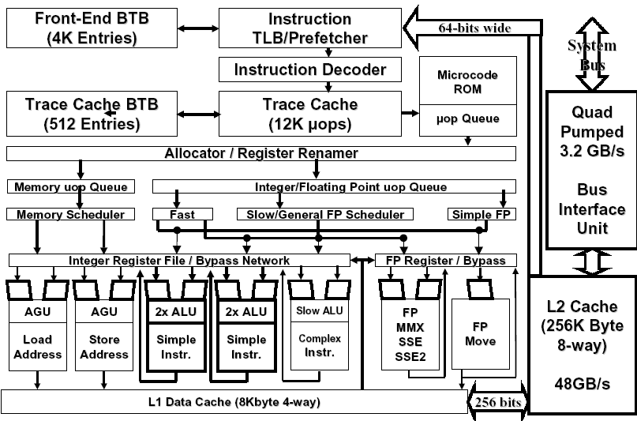
Pentium® 4
Processor Microarchitecture
Intel Technology Journal, 2001
Notes:
BTB = Branch target buffer, keeps track of branches

Slide 12
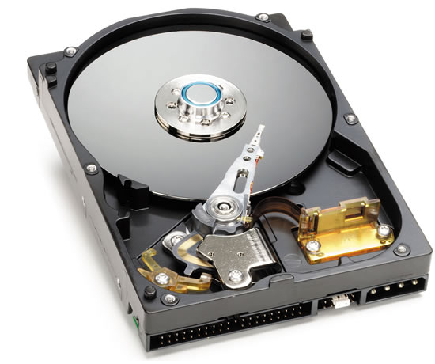
Inside a Harddisk

Slide 13
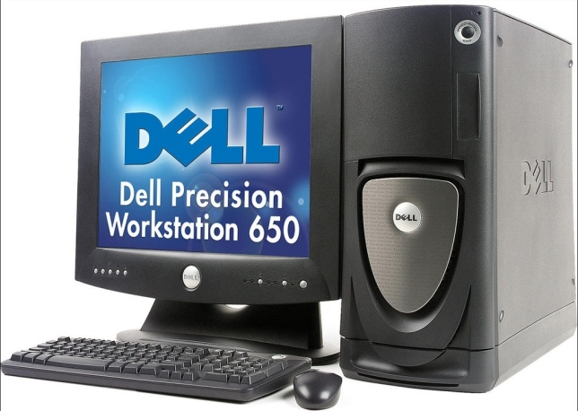

Customizing a Dell 650
Processor speed 2.4 – 3.2 GHz
L3 cache size 0.5 – 2 MB
Memory 1/4 – 4 GB
Hard Disk 36 GB– 146 GB
7.200 – 15.000 RPM
CD/DVD 8 – 48x
L2 cache size 256 – 512 KB
L2 cache line size 128 Bytes
L1 cache line size 64 Bytes
L1 cache size 16 KB
www.dell.com
www.intel.com
Notes:
Dell’s homepage July 2004

Slide 14
Memory Access Times
 | Latency | Relative to CPU
Register | 0.5 ns | 1
L1 cache | 0.5 ns | 1-2
L2 cache | 3 ns | 2-7
DRAM | 150 ns | 80-200
TLB | 500+ ns | 200-2000
Disk | 10 ms | 10⁷
Increasing

Slide 15
A Trivial Program

Slide 16
A Trivial Program
for (i=0; i+d<n; i+=d) A[i]=i+d;
A[i]=0;
for (i=0, j=0; j<8*1024*1024; j++) i = A[i];
d
A
n
Notes:
Elements are integers
Program does ”Pointer chasing”

Slide 17
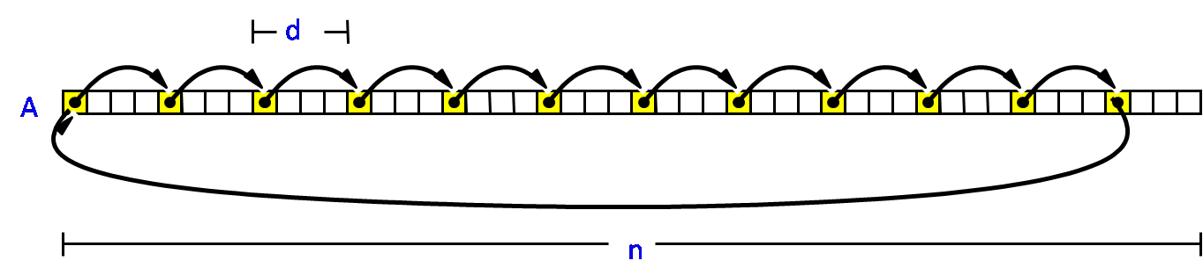
A Trivial Program — d=1
RAM : n ≈ 2²⁵ = 128 MB

Slide 18
A Trivial Program — d=1
L1 : n ≈ 2¹² = 16 KB
L2 : n ≈ 2¹⁶ = 256 KB

Slide 19
A Trivial Program — n=2²⁴
Notes:
Lot of hardware design fluences the running time
Cache line size ~ 32 Bytes?; Page size ~ 4 KB; Cache associativity; TLB
Has only been run for d being a power of two

Slide 20
A Trivial Program
— hardward specification
Experiments were performed on a DELL 8000, PentiumIII,
850MHz, 128MB RAM, running Linux 2.4.2, and using
gcc version 2.96 with optimization -O3
L1 instruction and data caches
4-way set associative, 32-byte line size
16KB instruction cache and 16KB write-back data cache
L2 level cache
8-way set associative, 32-byte line size
256KB
www.Intel.com

Slide 21
Hierarchical Memory Models

Slide 22
Algorithmic Problem
Modern hardware is not uniform — many different parameters
  Number of memory levels
  Cache sizes
  Cache line/disk block sizes
  Cache associativity
  Cache replacement strategy
  CPU/BUS/memory speed
Programs should ideally run for many different parameters
  by knowing many of the parameters at runtime, or
  by knowing few essential parameters, or
  ignoring the memory hierarchies
Programs are executed on unpredictable configurations
  Generic portable and scalable software libraries
  Code downloaded from the Internet, e.g. Java applets
  Dynamic environments, e.g. multiple processes
Practice

Slide 23
Hierarchical Memory – Abstract View
R
CPU
L1
L2
L3
A
Disk
M
Increasing
access time
and space
Notes:
Data movements in blocks between adjacent levels

Slide 24
Hierarchical Memory Models
— many parameters
M₄
M₃
M₂
B₃
M₁
B₁
R
CPU
L1
L2
L3
A
Disk
B₂
M
B₄
Increasing
access time
and space
Limited success because to complicated

Slide 25
External Memory Model— two parameters
Aggarwal and Vitter 1988
Measure number of block transfers
between two memory levels
Bottleneck in many computations
Very successful (simplicity)
Limitations
Parameters B and M must be known
Does not handle multiple memory levels
Does not handle dynamic M
I/O
c
B
M
a
e
CPU
c
m
h
o
e
r
y
M
Notes:
Dynamic M = multiple processes on a single processor

Slide 26
Ideal Cache Model— no parameters !?
Frigo, Leiserson, Prokop, Ramachandran 1999
Program with only one memory
Analyze in the I/O model for
Optimal off-line cache replacement
strategy arbitrary B and M
Advantages
Optimal on arbitrary level → optimal on all levels
Portability, B and M not hard-wired into algorithm
Dynamic changing parameters
I/O
c
B
M
a
e
CPU
c
m
h
o
e
r
y
M

Slide 27
Justification of the Ideal-Cache Model
Frigo, Leiserson, Prokop, Ramachandran 1999
Optimal replacement LRU + 2 × cache size → at most 2 × cache misses
Sleator and Tarjan, 1985
Corollary
T_{M,B}(N) = O(T_{2M,B}(N)) ) #cache misses using LRU is O(T_{M,B}(N))
Two memory levels
Optimal cache-oblivious algorithm satisfying T_{M,B}(N) = O(T_{2M,B}(N))
→ optimal #cache misses on each level of a multilevel LRU cache
Fully associativity cache
Simulation of LRU
Direct mapped cache
Explicit memory management
Dictionary (2-universal hash functions) of cache lines in memory
Expected O(1) access time to a cache line in memory

Slide 28
Basic External-Memory and
Cache-Oblivious Results

Slide 29
Scanning
sum = 0
for i = 1 to N do sum = sum + A[i]
B
A
N
O(N/B) I/Os
Corollary External/Cache-oblivious selection requires O(N/B) I/Os
Hoare 1961 / Blum et al. 1973

Slide 30
External-Memory Merging
2
2
3
3
5
5
6
6
9
9
11
13
15
19
21
25
27
1
4
7
10
14
29
33
41
49
51
52
57
k-way
1
2
3
4
5
6
7
8
9
10
11
12
13
14
merger
8
12
16
18
22
24
31
34
35
38
42
46
write
17
20
23
26
28
30
32
37
39
43
45
50
read
Merging k sequences with N elements requires O(N/B) IOs provided k ≤ M/B - 1

Slide 31
External-Memory Sorting
...
M
M
N
Unsorted input
Partition into runs
Run 1
Run 2
Run N/M
Sort each run
Sorted
Sorted
Sorted
Merge pass I
Sorted
Sorted
Merge pass II
Sorted ouput
θ(M/B)-way MergeSort achieves optimal O(Sort(N)=O(N/B·log_{M/B}(N/B)) I/Os
Aggarwal and Vitter 1988

Slide 32
Cache-Oblivious Merging
Frigo, Leiserson, Prokop, Ramachandran 1999
k-way merging (lazy) using binary merging with buffers
tall cache assumption M ≥ B²
O(N/B·log_{M/B} k) IOs
M_{top}
B₁
B _{k}
...
M₁
...
M _{k}

Slide 33
Cache-Oblivious Sorting – FunnelSort
Frigo, Leiserson, Prokop and Ramachandran 1999
Divide input in N^{1/3} segments of size N^{2/3}
Recursively FunnelSort each segment
Merge sorted segments by an N^{1/3}-merger
Theorem Provided M ≥ B² performs optimal O(Sort(N)) I/Os

Slide 34
Sorting (Disk)
Brodal, Fagerberg, Vinther 2004
Notes:
Pentium 4
GCC = quicksort, msort = Ladner binary mergesort, Rmerge = register optimized, TPIE = mulitway mergesort

Slide 35
Sorting (RAM)
Brodal, Fagerberg, Vinther 2004
Notes:
Pentium 4
GCC = quicksort, msort = Ladner binary mergesort, Rmerge = register optimized, TPIE = mulitway mergesort

Slide 36
External Memory Search Trees
B-trees Bayer and McCreight 1972
Searches and updates use O(log_{B} N) I/Os
degree O(B)
Search/update path
Notes:
Disk searches, 4-5 disk IOs per search – reduces if top of tree is kept in cache

Slide 37
Cache-Oblivious Search Trees
Recursive memory layout (van Emde Boas) Prokop 1999
A
h/2
h
...
h/2
B₁
B_{k}
...
A
B₁
...
B_{k}
Binary tree
Searches use O(log_{B} N) I/Os
Dynamization (several papers) – ”reduction to static layout”
Notes:
Does not know B – apply recursion.

Slide 38
Cache-Oblivious Search Trees
Brodal, Jacob, Fagerberg 1999

Slide 39
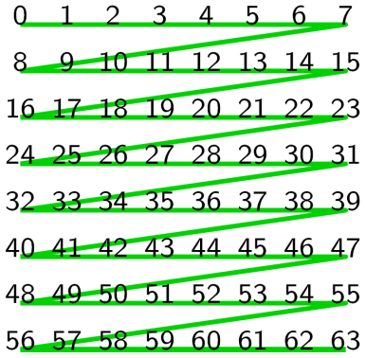
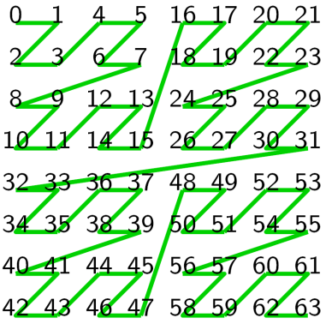
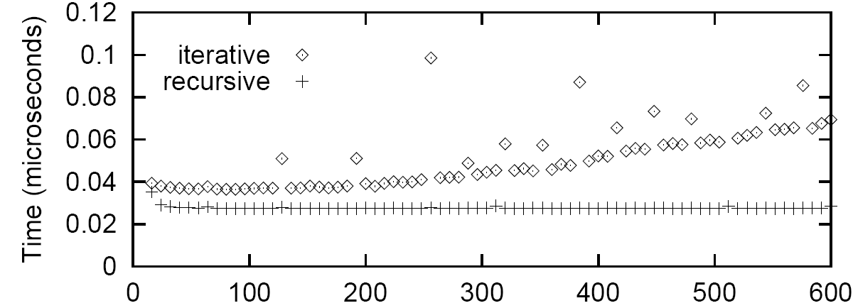
Matrix Multiplication
Frigo, Leiserson, Prokop and Ramachandran 1999
Iterative: Recursive:
O(N ³) I/Os I/Os
N
Average time taken to multiply two N x N matrics divided by N³

Slide 40
Cache-Oblivious Summary
The ideal cache model helps designing competitive and robust algorithms
Basic techniques: Scanning, recursion/divide-and-conquer, recursive memory layout, sorting
Many other problems studied: Permuting, FFT, Matrix transposition, Priority queues, Graph algorithms, Computational geometry...
Overhead involved in being cache-oblivious can be small enough for the nice theoretical properties to transfer into practical advantages

Slide 41
The Influence of other Chip Technologies...
....why some experiments do not turn out as expected

Slide 42
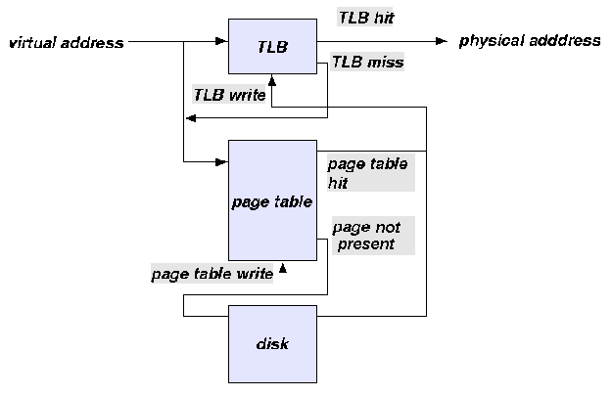
Translation Lookaside Buffer (TLB)
translate virtual addresses into physical addresses
small table (full associative)
TLB miss requires lookup to the page table
  Size: 8 - 4,096 entries
  Hit time: 0.5 - 1 clock cycle
  Miss penalty: 10 - 30 clock cycles
wikipedia.org
Notes:
TLB can be viewed as a level of the memory hierarchy – few blocks of size ~4096 (64-128 entries in TLB table)
WAE’99: Naila Rahman and Rajeev Raman

Slide 43
TLB and Radix Sort
Rahman and Raman 1999
Time for one permutation phase

Slide 44
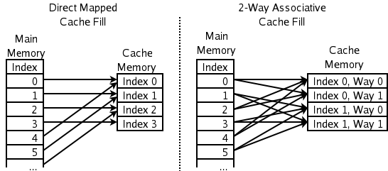
Cache Associativity
wikipedia.org
Execution times for scanning k sequences of total length N=2²⁴ in round-robin fashion (SUN-Sparc Ultra, direct mapped cache)
Cache associativity
TLB misses
Sanders 1999
Notes:
Solutions avoiding the collisions: start an array at a random address

Slide 45
TLB and Radix Sort
Rahman and Raman 1999
TLB optimized
Notes:
Input random 32 bit intergers
PLSB & EPLSB: Each permutation rounds works in two phases: (i) local phase working on blocks, and
(ii) global phase permutes within block

Slide 46
Prefetching vs. Caching
Pan, Cherng, Dick, Ladner 2007
All Pairs Shortest Paths (APSP)
Organize data so that the CPU can prefetch the data
→ computation (can) dominate cache effects
Prefetching disabled
Prefetching enabled
Notes:
Paper presented at ALENEX’07:
Floyd-Warshall bad locallity but prefetching cancelles out the deficits of :
GEP (Gaussian Ellimnation Paradigm, SODA’06, Chowdhurri and Ramachandran): Blocked GEP,
MMP (Matrix Multiply Paradigm), Blocked MMP
Blocking avoid overhead at the bottom of the recursion.

Slide 47
Branch Prediction vs. Caching
QuickSort Select the pivot biased to achieve subproblems of size α and 1-α
+ reduces # branch mispredictions
- increases # instructions and # cache faults
Kaligosi and Sanders 2006

Slide 48
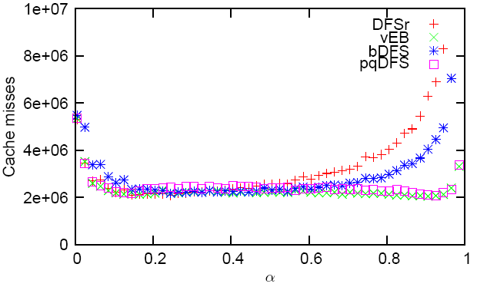
Branch Prediction vs. Caching
Skewed Search Trees Subtrees have size α and 1-α
+ reduces # branch mispredictions
- increases # instructions and # cache faults
Brodal and Moruz 2006
α
1-α

Slide 49
Another Trivial Program
— the influence of branch predictions
for(i=0;i<n;i++)
A[i]=rand()% 1000;
for(i=0;i<n;i++)
if(A[i]>threshold)
g++;
else
s++;
A
n

Slide 50
Branch Mispredictions
for(i=0;i<n;i++)
a[i]=rand()% 1000;
for(i=0;i<n;i++)
if(a[i]>threshold)
g++;
else
s++;
Worst-case #mispredictions for thresholds 0..1000
Notes:
Plots show the cases where the outer for-loop is unrolled 2,4, and 8 times
Experiments performed on which machine???

Slide 51
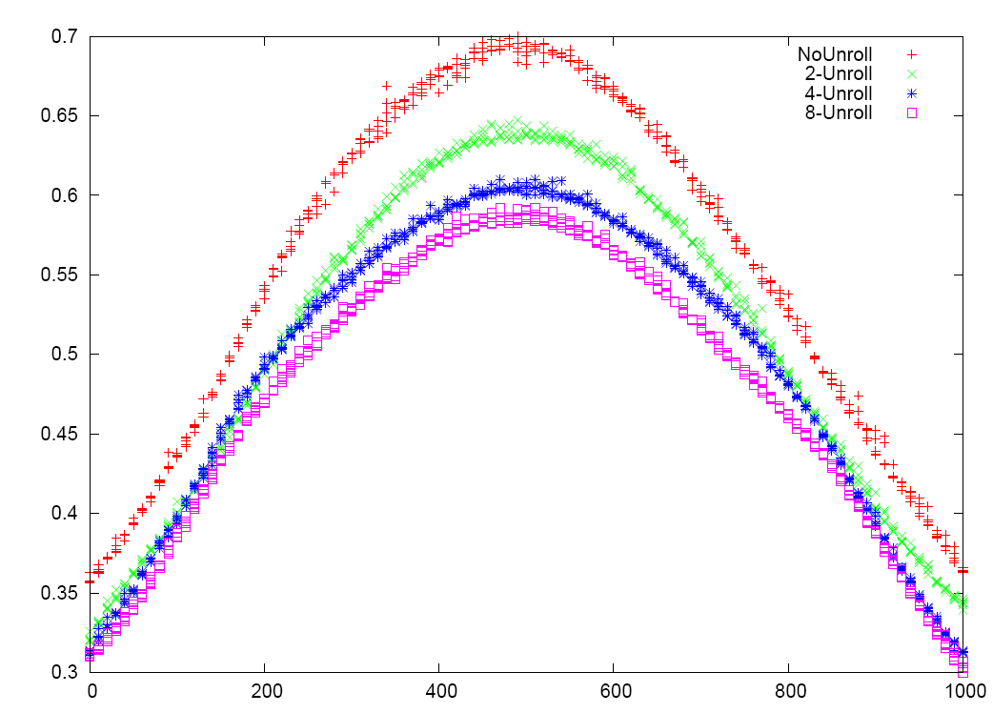
Running Time
for(i=0;i<n;i++)
a[i]=rand()% 1000;
for(i=0;i<n;i++)
if(a[i]>threshold)
g++;
else
s++;
Prefetching disabled
Prefetching disabled
  → 0.3 - 0.7 sec
Prefetching enabled
  → 0.15 – 0.5 sec
Prefetching enabled

Slide 52
L2 Cache Misses
for(i=0;i<n;i++)
a[i]=rand()% 1000;
for(i=0;i<n;i++)
if(a[i]>threshold)
g++;
else
s++;
Prefetching disabled
Prefetching disabled
  → 2.500.000 cache misses
Prefetching enabled
  → 40.000 cache misses
Prefetching enabled
Notes:
L2 cache misses withwout prefeetching is the expected given a cache line size of 64 bytes
With prefetching, there are cache-misses about every 4000 element = page size, ie for every TLB miss
array = 40.000.000 integers = 160.000.000 bytes = 2.500.000 cache lines (cache line = 64 bytes = 512 bits)
Plot shows PAPI_L2_TCM

Slide 53
L1 Cache Misses
for(i=0;i<n;i++)
a[i]=rand()% 1000;
for(i=0;i<n;i++)
if(a[i]>threshold)
g++;
else
s++;
Prefetching disabled
Prefetching disabled
  → 4 – 16 x 10⁶ cache misses
Prefetching enabled
  → 2.5 – 5.5 x 10⁶ cache misses
Prefetching enabled
Notes:
Plot shows: PAPI_L1_DCM
L1 ??? Should have counted total number of L1 cache loads instead of misses?

Slide 54
Summary
Be conscious about the presence of memory hierarcies when designing algorithms
Experimental results not often quite as expected due to neglected hardware features in algorithm design
External memory model and cache-oblivious model adequate models for capturing disk/cache buttlenecks

Slide 55
What did I not talk about...
non-uniform memory
parallel disks
parallel/distributed algorithms
graph algorithms
computational geometry
string algorithms
and a lot more...

Slide 56
Overview
Computer ≠ Unit Cost RAM
Overview of Computer Hardware
A Trivial Program
Hierarchical Memory Models
Basic Algorithmic Results for Hierarchical Memory
The influence of other Chip Technologies
Theory Practice

