Slide 1
Word RAM Algorithms
International PhD School in Algorithms for Advanced Processor Architectures - AFAPA
Gerth Stølting Brodal
University of Aarhus
Monday June 9, 2008, IT University of Copenhagen, Denmark
Notes:
Thanks to Rasmus & Thore for inviting me
This will be a theory talk
Presentation of participants

Slide 2
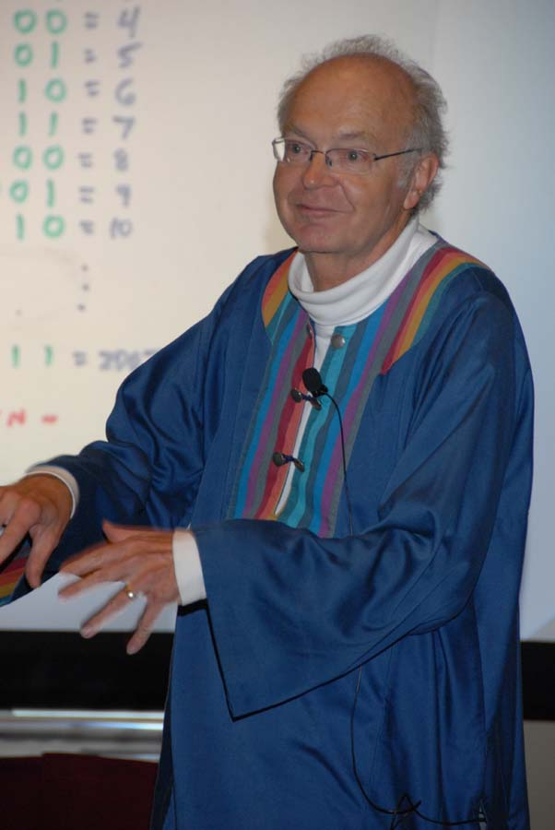
Lecture Material
Notes:
Knuth wrote 118 pages on the topic of bit-tricks, incl 114 exercises
Technique = trick that is used 2 or more times ☺

Slide 3
Background...
Computer word sizes have increased over time
(4 bits, 8 bits, 12 bits, 16 bits, 32 bits, 64 bits, 128 bits, ...GPU...)
What is the power and limitations of
word computations?
How can we exploit word parallellism?
Notes:
128 bits is eg found on Intel’s Streaming SIMD Extension
+ This is theory talk – details about GPU handling separate topic
+ Philip Bille asked me to give you some exercises? – Talk structured as a seuquence of exercises

Slide 4
Overview
Word RAM model
Words as sets
Bit-manipulation on words
Trees
Searching
Sorting
Word RAM results

Slide 5
Word RAM Model

Slide 6
Word RAM (Random Access Machine)
n
011001101
0
Unlimited memory
Word = n bits
CPU, O(1) registers
CPU, read & write memory words
set[i,v], get[i]
CPU, computation:
Boolean operations
Arithmetic operations: +, -, (*)
Shifting: x<<k = x∙2^{k} , x>>k = ⎣x/ 2^{k}⎦
Operations take O(1) time
101111101
1
001011101
2
100101000
3
011001101
4
011001101
5
CPU
101111101
6
7
001011101
100101000
…
011001101
101111101
001011101
100101000
101111101
i
001011101
100101000
011001101
101111101
001011101
100101000
0110011
111000
01101
1111
01
Notes:
multiplication requires more complex circuits and requires longer to compute than addition
* Peter Bro Miltersen will in the afternoon give a detailed study of the limitations
if mulitplications is not available

Slide 7
Word RAM – Boolean operations
AND | 0 | 1
0 | 0 | 0
1 | 0 | 1
OR | 0 | 1
0 | 0 | 1
1 | 1 | 1
XOR | 0 | 1
0 | 0 | 1
1 | 1 | 0
x | ~ x
0 | 1
1 | 0
0 = False, 1 = True
Corresponding word operations work on all
n bits in one or two words in parallel.
Example: Clear a set of bits using AND
 | 0 | 0 | 1 | 1 | 1 | 0 | 1 | 0 | 1 | 1 | 1 | 1
AND | 0 | 1 | 1 | 1 | 0 | 1 | 1 | 1 | 0 | 1 | 1 | 1
 | 0 | 0 | 1 | 1 | 0 | 0 | 1 | 0 | 0 | 1 | 1 | 1

Slide 8
The first tricks...

Slide 9
Exercise 1
Consider a double-linked list, where each node has three fields: prev, next, and an element.
Usually prev and next require one word each.
Question. Describe how prev and next for a node can be combined into one word, such that navigation in a double-linked list is still possible.
prev(p)
p
x₁
x₂
x₃
x₄
prev
next
Notes:
Prev XOR next

Slide 10
Exercise 2
Question.
How can we pack an array of N 5-bit
integers into an array of 64-bit words,
such that
we only use ≈ N∙5/64 words, and
we can access the i’th 5-bit integer efficiently ?
64 bits
01011
01011
01011
waste
01011
01011
01011
01011
01011
01011
01011
how not to do it
Notes:
* This is more than a trick – it is a technique

Slide 11
Words as Sets

Slide 12
Words as Sets
Would like to store subsets of {0,1,2,...,n-1} in an n-bit word.
The set {2,5,7,13} can e.g. be represented by
the following word (bit-vector):
15 | 14 | 13 | 12 | 11 | 10 | 9 | 8 | 7 | 6 | 5 | 4 | 3 | 2 | 1 | 0
0 | 0 | 1 | 0 | 0 | 0 | 0 | 0 | 1 | 0 | 1 | 0 | 0 | 1 | 0 | 0

Slide 13
Exercise 3
Question.
How can we perform the following set operations
efficiently, given two words representing S₁ and S₂:
S₃ = S₁ ∩ S₂
S₃ = S₁ ∪ S₂
S₃ = S₁ \ S₂

Slide 14
Exercise 4
Question.
How can we perform the following set queries, given words representing the sets:
x ∈ S ?
S₁ ⊆ S₂ ?
Disjoint(S₁, S₂) ?
Disjoint(S₁, S₂,..., S_{k} ) ?
Notes:
Exercise 78
S AND 1<<x
S1 AND S2 = 0
d) S1 OR S2 OR Sk = S1 + S2+ …+ Sk

Slide 15
Exercise 5
Question.
How can we perform compute |S|, given S as a word (i.e. numer of bits = 1)?
without using multiplication
using multiplication
15 | 14 | 13 | 12 | 11 | 10 | 9 | 8 | 7 | 6 | 5 | 4 | 3 | 2 | 1 | 0
0 | 0 | 1 | 0 | 0 | 0 | 0 | 0 | 1 | 0 | 1 | 0 | 0 | 1 | 0 | 0
S
|S|= 4
Notes:
Binary tree computation (divide-and-conquer)
loglog n reduction, and apply multiplication to sum neighbourhing fields.
b) Equation 62

Slide 16
Bit-manipulations on Words

Slide 17
Exercise 6
Question.
Describe how to efficiently reverse a word S.
15 | 14 | 13 | 12 | 11 | 10 | 9 | 8 | 7 | 6 | 5 | 4 | 3 | 2 | 1 | 0
0 | 1 | 0 | 0 | 0 | 0 | 0 | 0 | 1 | 0 | 1 | 0 | 0 | 1 | 0 | 0
S
reverse(S)
15 | 14 | 13 | 12 | 11 | 10 | 9 | 8 | 7 | 6 | 5 | 4 | 3 | 2 | 1 | 0
0 | 0 | 1 | 0 | 0 | 1 | 0 | 1 | 0 | 0 | 0 | 0 | 0 | 0 | 1 | 0
Notes:
Equation 65

Slide 18
Exercise 7
Question.
How can we efficiently compute the zipper
y_{n/2-1}x_{n/2-1}...y₂x₂y₁x₁y₀x₀
of two half-words x_{n/2-1}...x₂x₁x₀ and y_{n/2-1}...y₂y₁y₀ ?
Whitcomb Judson developed
the first commercial zipper
(named the Clasp Locker) in 1893.
Notes:
Applications to space filling curves
Divide-and-conquer
Page 16

Slide 19
Exercise 8
Question.
Describe how to compress a subset of the bits
w.r.t. an arbitrary set of bit positions i_{k}>∙∙∙>i₂>i₁:
compress(x_{n-1},...,x₂,x₁,x₀) = 0....0x_{ik}...x_{i2}x_{i1}
15 | 14 | 13 | 12 | 11 | 10 | 9 | 8 | 7 | 6 | 5 | 4 | 3 | 2 | 1 | 0
0 | 1 | 0 | 0 | 1 | 0 | 0 | 0 | 0 | 0 | 1 | 0 | 1 | 1 | 0 | 1
i₄=14, i₃=7, i₂=5, i₁=2
compress(x)
15 | 14 | 13 | 12 | 11 | 10 | 9 | 8 | 7 | 6 | 5 | 4 | 3 | 2 | 1 | 0
0 | 0 | 0 | 0 | 0 | 0 | 0 | 0 | 0 | 0 | 0 | 0 | 1 | 0 | 1 | 1
Notes:
Equation 50

Slide 20
Exercise 9
Question.
Describe how to remove the rightmost 1
Describe how to extract the rightmost 1
15 | 14 | 13 | 12 | 11 | 10 | 9 | 8 | 7 | 6 | 5 | 4 | 3 | 2 | 1 | 0
0 | 0 | 1 | 1 | 0 | 0 | 0 | 1 | 1 | 0 | 1 | 1 | 0 | 0 | 0 | 0
15 | 14 | 13 | 12 | 11 | 10 | 9 | 8 | 7 | 6 | 5 | 4 | 3 | 2 | 1 | 0
0 | 0 | 1 | 1 | 0 | 0 | 0 | 1 | 1 | 0 | 1 | 0 | 0 | 0 | 0 | 0
remove
extract
15 | 14 | 13 | 12 | 11 | 10 | 9 | 8 | 7 | 6 | 5 | 4 | 3 | 2 | 1 | 0
0 | 0 | 0 | 0 | 0 | 0 | 0 | 0 | 0 | 0 | 0 | 1 | 0 | 0 | 0 | 0
Notes:
Equation 36
Equation 37

Slide 21
Exercise 10
Question.
Describe how to compute the position ρ(x) of the rightmost 1 in a word x
without using multiplication
using multiplication
using integer-to-float conversion
15 | 14 | 13 | 12 | 11 | 10 | 9 | 8 | 7 | 6 | 5 | 4 | 3 | 2 | 1 | 0
0 | 0 | 1 | 1 | 0 | 0 | 0 | 1 | 1 | 0 | 1 | 1 | 0 | 0 | 0 | 0
x
ρ(x) = 4
Notes:
Equation 56
c) Equation 55

Slide 22
Exercise 11
Let λ(x) be the position of the leftmost 1 in a word x (i.e. λ(x) = ⎣log₂(x)⎦).
Question.
Describe how to test if λ(x)= λ(y),
without actually computing λ(x) and λ(y).
15 | 14 | 13 | 12 | 11 | 10 | 9 | 8 | 7 | 6 | 5 | 4 | 3 | 2 | 1 | 0
0 | 0 | 0 | 0 | 1 | 1 | 0 | 1 | 0 | 0 | 1 | 1 | 0 | 1 | 0 | 0
x
λ(x) = 11
Notes:
Equation 58

Slide 23
Exercise 12*
Question.
Describe how to compute the position λ(x) of the leftmost 1 in a word x (i.e. λ(x) = ⎣log₂(x)⎦)
without using multiplication
using multiplication
using integer-to-float conversion
15 | 14 | 13 | 12 | 11 | 10 | 9 | 8 | 7 | 6 | 5 | 4 | 3 | 2 | 1 | 0
0 | 0 | 0 | 0 | 1 | 1 | 0 | 1 | 0 | 0 | 1 | 1 | 0 | 1 | 0 | 0
x
λ(x) = 11
Notes:
Algorithm B

Slide 24
Fredman & Willard
Computation of λ(x) in O(1) steps using 5 multiplications
n = g∙g, g a power of 2
Notes:
Page 22, n=g*g, g is a power of 2.
Not of practical interest

Slide 25
Exercise 13
Question.
Describe how to compute the length of the longest common prefix of two words
x_{n-1}...x₂x₁x₀ and y_{n-1}...y₂y₁y₀
15 | 14 | 13 | 12 | 11 | 10 | 9 | 8 | 7 | 6 | 5 | 4 | 3 | 2 | 1 | 0
0 | 0 | 1 | 1 | 0 | 0 | 0 | 1 | 1 | 0 | 1 | 1 | 0 | 0 | 0 | 0
x
y
15 | 14 | 13 | 12 | 11 | 10 | 9 | 8 | 7 | 6 | 5 | 4 | 3 | 2 | 1 | 0
0 | 0 | 1 | 1 | 0 | 0 | 1 | 1 | 0 | 0 | 1 | 0 | 1 | 1 | 0 | 0
lcp(x,y) = 6
Notes:
Lambda(X XOR Y)

Slide 26
Trees

Slide 27
Exercise 14
Question.
Consider the nodes of a complete binary tree being numbered level-by-level and the root being numbered 1.
What are the numbers of
the children of node i ?
What is the number of
the parent of node i ?
1
2
3
4
5
6
7
8
9
10
11
12
13
14
15
Notes:
Page 32
left: i<<1, right (i<<1) +1
i>>1

Slide 28
Exercise 15
Question.
How can the height of the tree be computed from a leaf number?
How can LCA(x,y) of two
leaves x and y be computed
(lowest common ancestor)?
1
LCA(x,y)
2
3
4
5
6
7
8
9
10
11
12
13
14
15
x y
Notes:
lamda(x)
X>>lambda(x XOR y)

Slide 29
Exercise 16*
Question.
Describe how to assign O(1) words
to each node in an arbitrary tree,
such that LCA(x,y) queries can
be answered in O(1) time.
LCA(x,y)
x
y
Notes:
Harel & Tarjan 1984
Page 33-44

Slide 30
Searching

Slide 31
Exercise 17
Question. Consider a n-bit word x storing k
n/k-bit values v₀,...,v_{k-1}
Describe how to decide if all v_{i} are non-zero
Describe how to find the first v_{i} equal to zero
Describe how implement Search(x,u), that
returns a i such that v_{i}=u (if such a v_{i} exists)
15 | 14 | 13 | 12 | 11 | 10 | 9 | 8 | 7 | 6 | 5 | 4 | 3 | 2 | 1 | 0
0 | 1 | 0 | 0 | 1 | 1 | 1 | 0 | 0 | 0 | 0 | 1 | 1 | 0 | 0 | 0
v₃ |  |  |  | v₂ |  |  |  | v₁ |  |  |  | v₀
x
Notes:
Equation 90

Slide 32
Sorting : Sorting Networks

Slide 33
Exercise 18
Question. Construct a comparison network that outputs the minimum of 8 input lines.
What is the number of comparators and the depth of the comparison network?
x₁
x₂
x₃
x₄
x₅
x₆
x₇
x₈
minimum
Notes:
Goal is: Depth log N

Slide 34
Exercise 19
Question. Construct a comparison network that outputs the minimum and maximum of 8 input lines. What is the number of comparators and the depth of the comparison network?
x₁
maximum
x₂
x₃
x₄
x₅
x₆
x₇
x₈
minimum

Slide 35
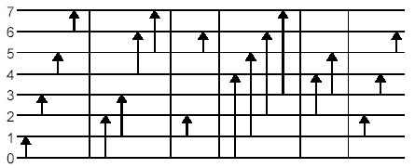
Odd-Even Merge Sort
K.E. Batcher 1968
Odd-even merge sort for N=8.
Size O(N∙(log N)²) and depth O((log N)²)
Fact. At each depth all compators have equal length
[ Ajtai, Komlós, Szemerédi 1983: depth O(log N), size O(N∙log N) ]
Notes:
Figure stolen from paper on particle simulations on GPUs – includes as a step sorting on a GPU using
odd-even merge sort

Slide 36
Sorting : Word RAM implementations of Sorting Networks

Slide 37
Exercise 20
Question.
Descibe how to sort two sub-words stored in a single word on a Word RAM ― without using branch-instructions
(implementation of a comparator)
x
y
input
1 | 0 | 0 | 1 | 1 | 1 | 0 | 1
output
1 | 1 | 0 | 1 | 1 | 0 | 0 | 1
max(x,y)
min(x,y)

Slide 38
Exercise 21
Question.
Consider a n-bit word x storing n/k-bit values v₀,...,v_{k-1.}
Describe a Word RAM implementation of odd-even merge sort with running O((log k)²).
Odd-even merge sort for N=8.

Slide 39
More about Sorting & Searching

Slide 40
Sorting N words
More about Sorting & Searching
Randomized | O(N ∙ (loglog N)^{1/2}) | Han & Thorup 2002
Deterministic | O(N ∙ loglog N) | Han 2002
Randomized AC⁰ | O(N ∙ loglog N) | Thorup 1997
Deterministic AC⁰ | O(N ∙ (loglog N)^{1+ε}) | Han & Thorup 2002
Dynamic dictionaries storing N words
Deterministic | O((log N/loglog N)^{1/2}) | Andersson & Thorup 2001
Deterministic AC⁰ | O((log N)^{3/4+o(1)})
Notes:
Sorting: First two bounds require MULTIPLICATION
Sorting: First bound requires MULTIPLICATION
See recent 2xJACM papers by Mikkel Thorup for details!

Slide 41
Summary

Slide 42
Summary
Many operations on words can be efficiently
without using multiplication
λ(x) and ρ(x) can be computed in O(1) time using multiplication, and O(loglog n) time without mult.
Parallellism can be achieved by packing several elements into one word
The great (theory) question:
Can N words be sorted on a Word RAM in O(N) time?

