Slide 1
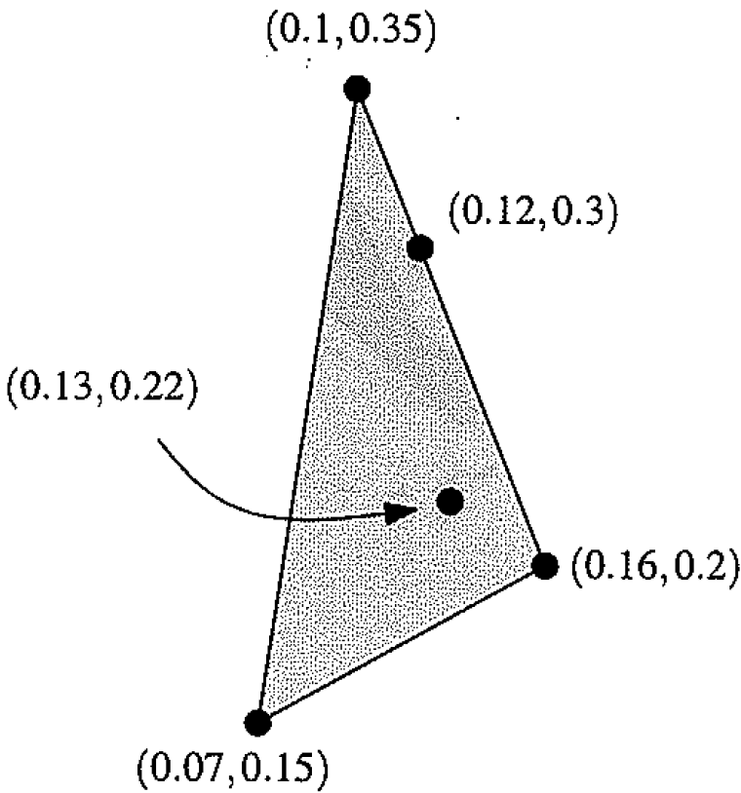
Notes:
Linear combination of points = convex hull

Slide 2
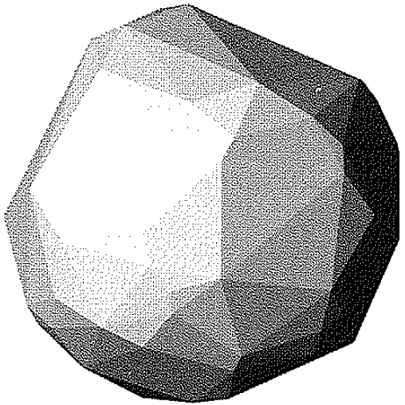
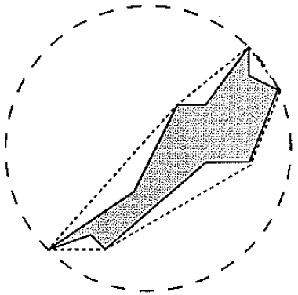
Notes:
Computer graphics, shape approximations: 1) Convex hull, 2) Bounding circle. Cicle faster to work fit, but worse approximation

Slide 3
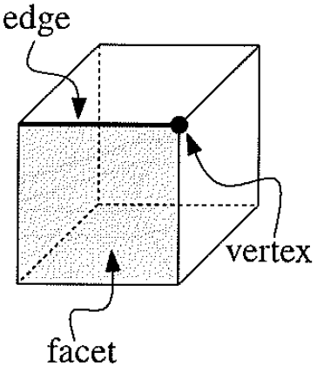
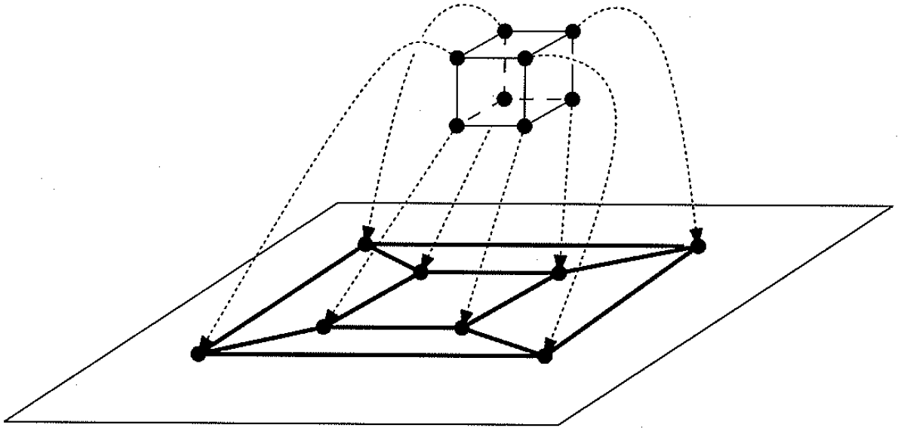
Notes:
CV = planar graph, ie O(n) faces and edges

Slide 4
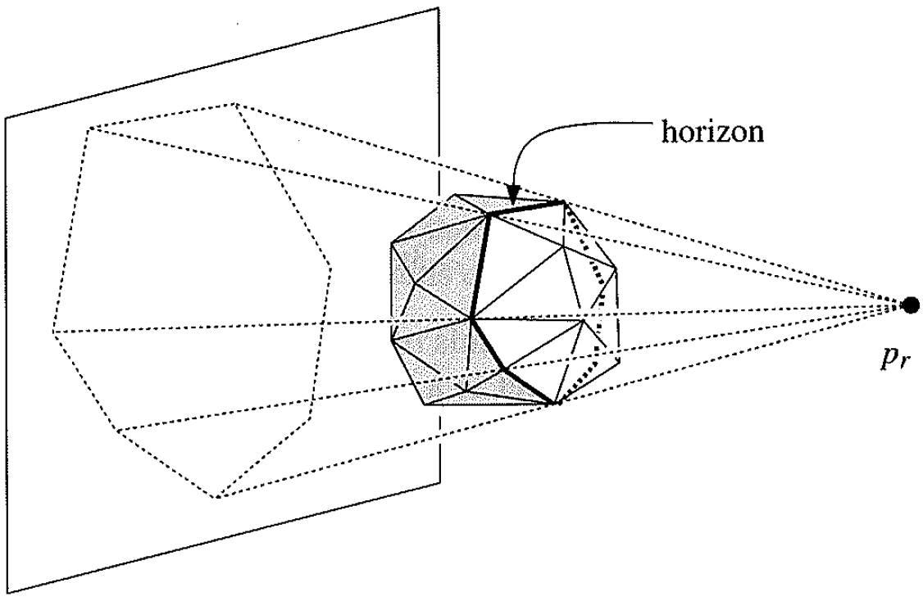
Notes:
Horizon of new point p_r =boundary of set of faces that need to be recomputed

Slide 5
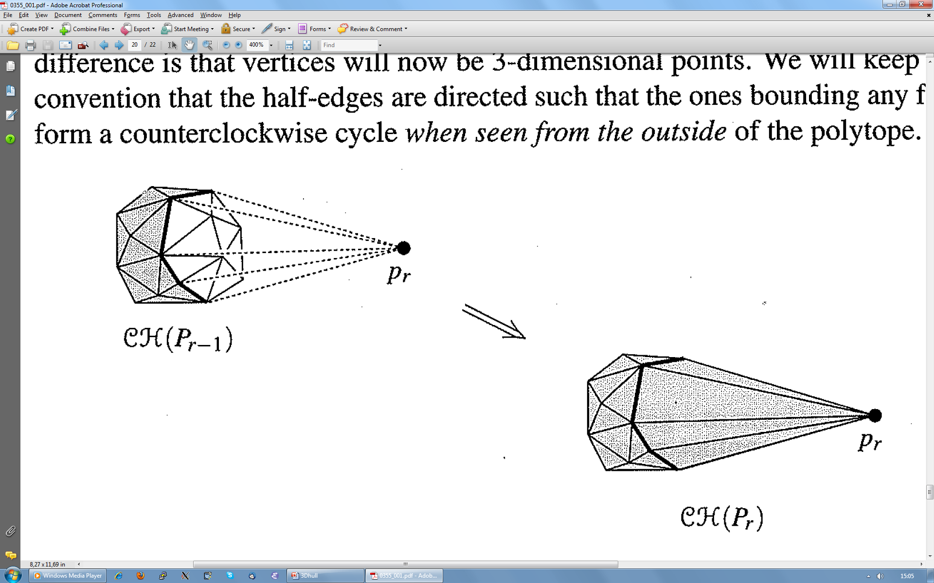
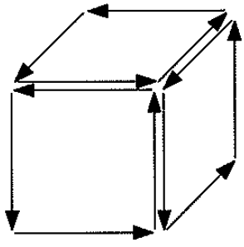
Notes:
Changes to convex hull by adding p_r.
Faces are ordered counter clockwise, to have consistent inside vs outside test of points against new facets.

Slide 6
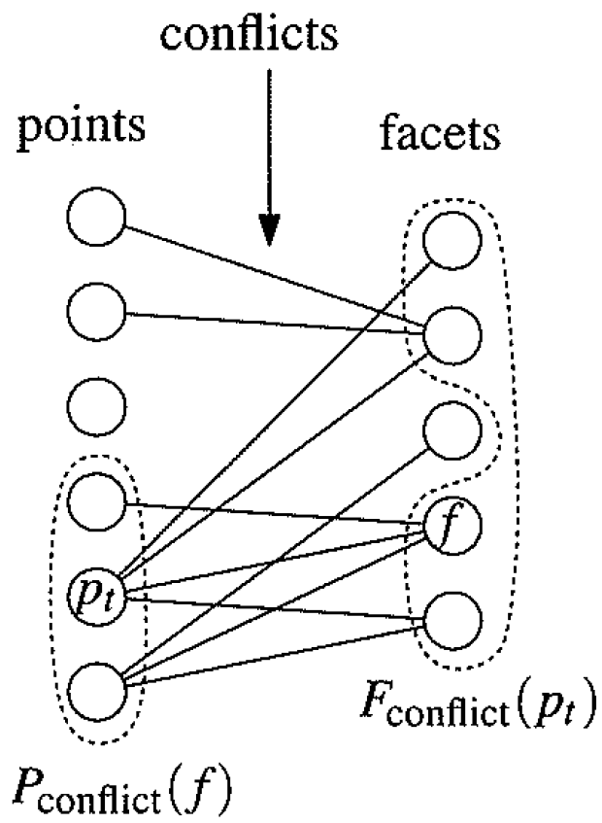
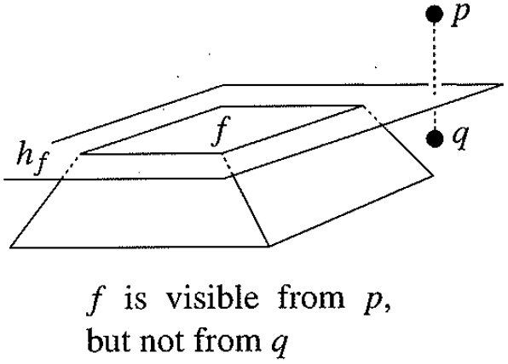
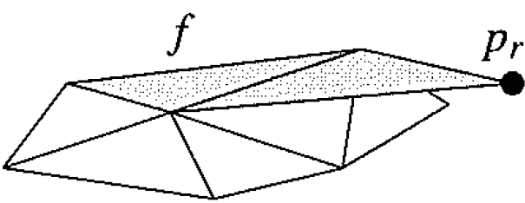
merge co-liniar facets
Notes:
Conflict graph.
Colinear facets should be merged

Slide 7
